Slide 2
shed

Slide 3
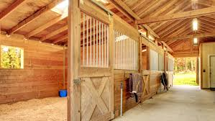
stall

Slide 4
barn

Slide 5
straw

Slide 6
kennel

Slide 7
hive

Slide 8
sty

Slide 9
pen

Slide 10
coop

Slide 11
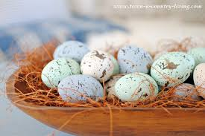
speckled egg

Slide 12
sack

Slide 13
Snuggly Snerd

Slide 14
muck

