Slide 1
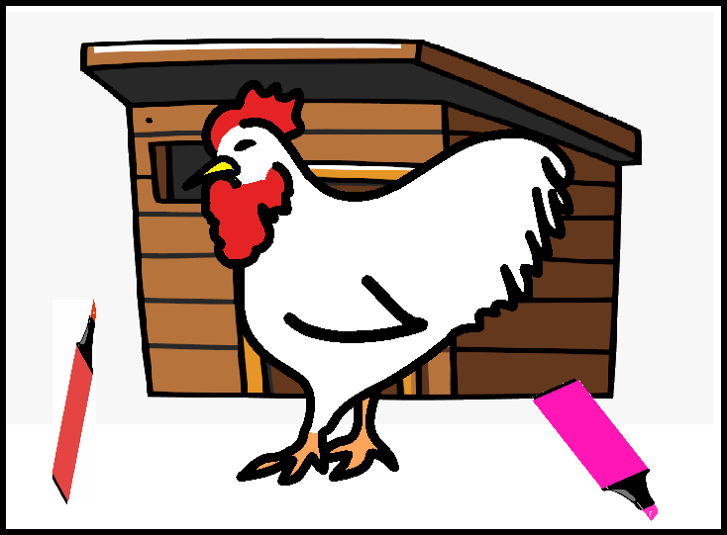
Meg the hen has 2 pens.
A thick pink pen and a thin red pen.

Slide 2
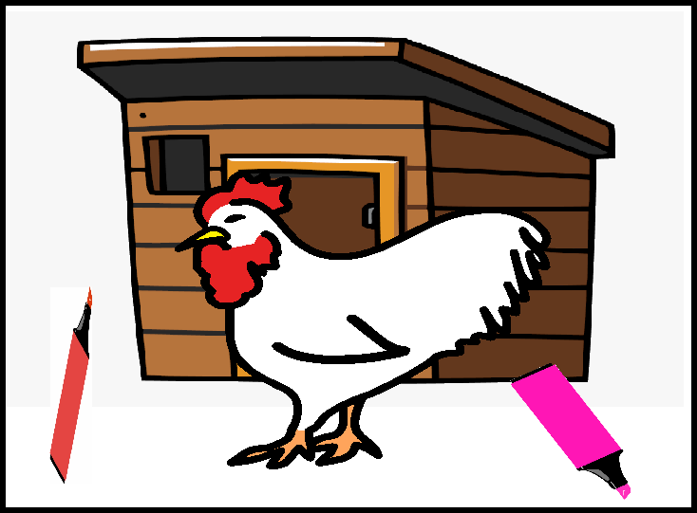
Meg
Meg the hen gets the thick pink pen and puts Meg on the shed.

Slide 3
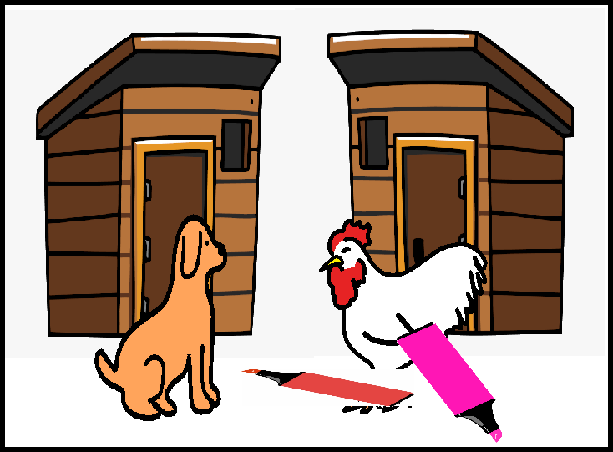
Sam
Meg
Sam the dog is Meg’s pal. Meg thinks. She gets the thin red pen and puts Sam on his shed.

Slide 4
Sam
Meg
Thank you Meg! Sam hugs Meg.
“My shed is the best.” Meg is glad.

