Slide 1
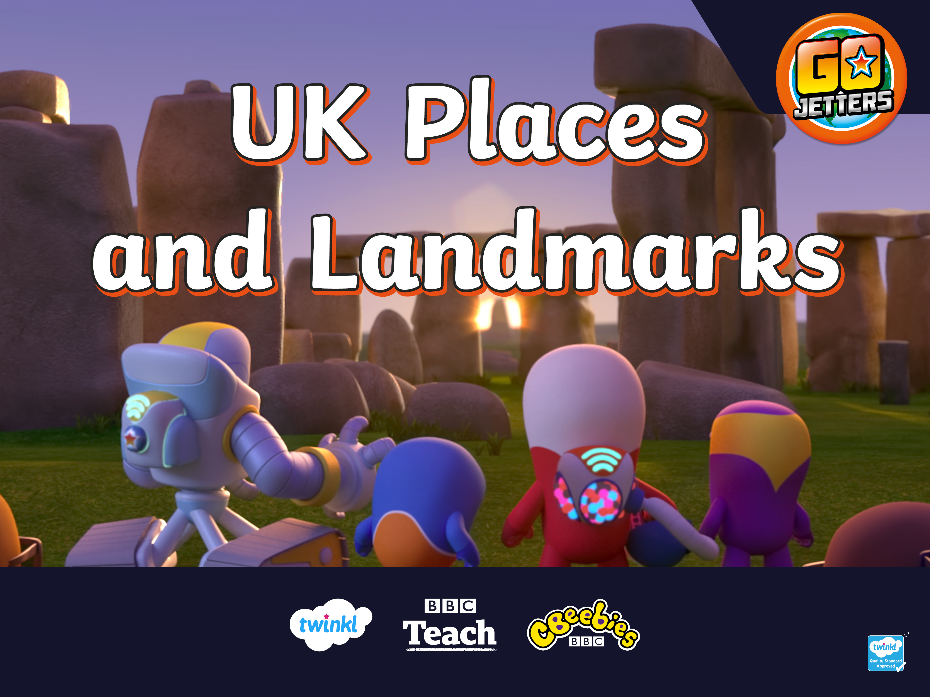

Slide 2
What Is a Landmark?
Hey, Go Jet Cadets, have you heard of the word ‘landmark’?
What do you think
it means?

Slide 3
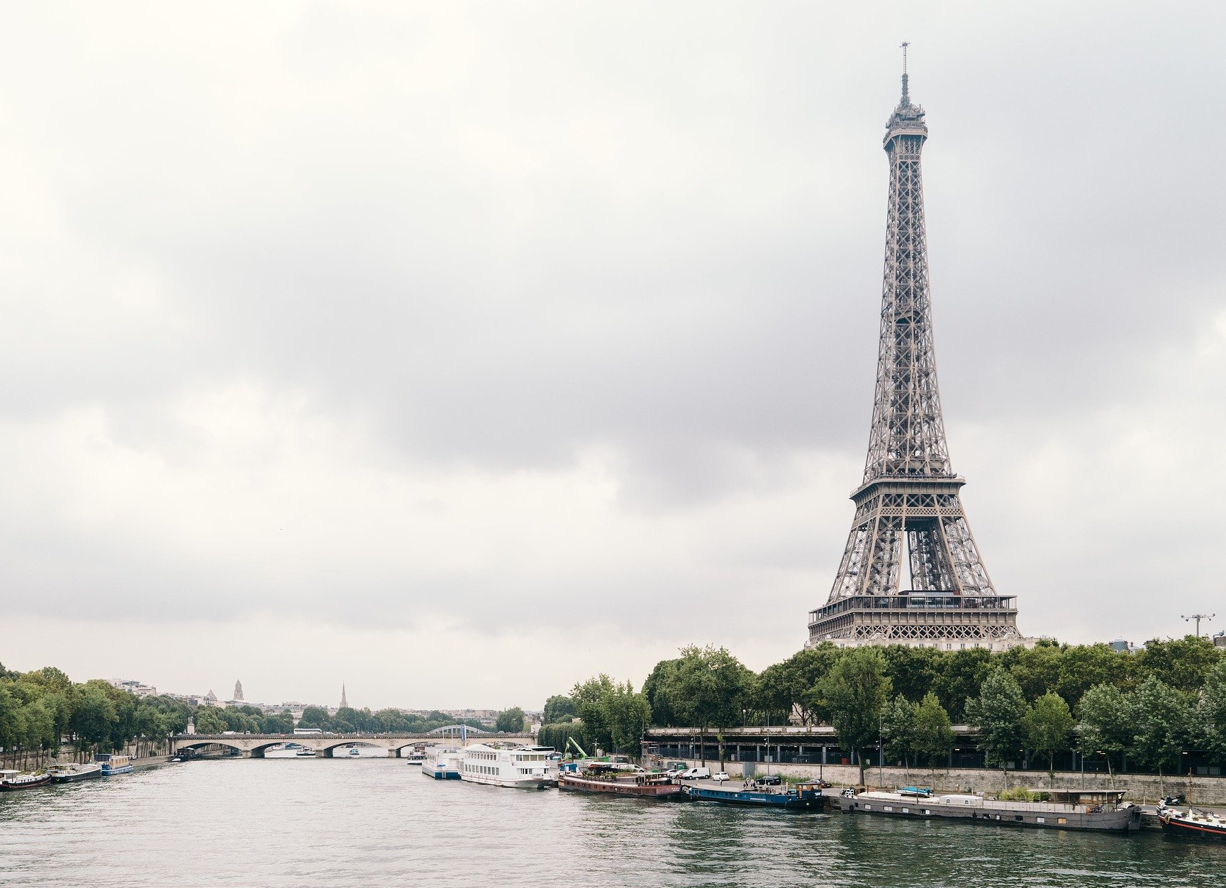
A landmark is something that stands out in an area. It could be a building, a bridge, a lake or river, a sculpture or something else. These places might be special because they are big, nice to look at or really old.
A landmark makes a place recognisable.
This means that you could look at a picture of a landmark and know straight away where it is.

Slide 4

Landmarks Near You
I love flying the Vroomster to different landmarks.

Slide 5
Landmarks Near You
Are there any landmarks near your school or where you live?
What are they?
Why are they special?

Slide 6
Famous Landmarks
Here are some pictures of famous landmarks around the world.
Do you recognise any of them?
Why are they special?

Slide 7

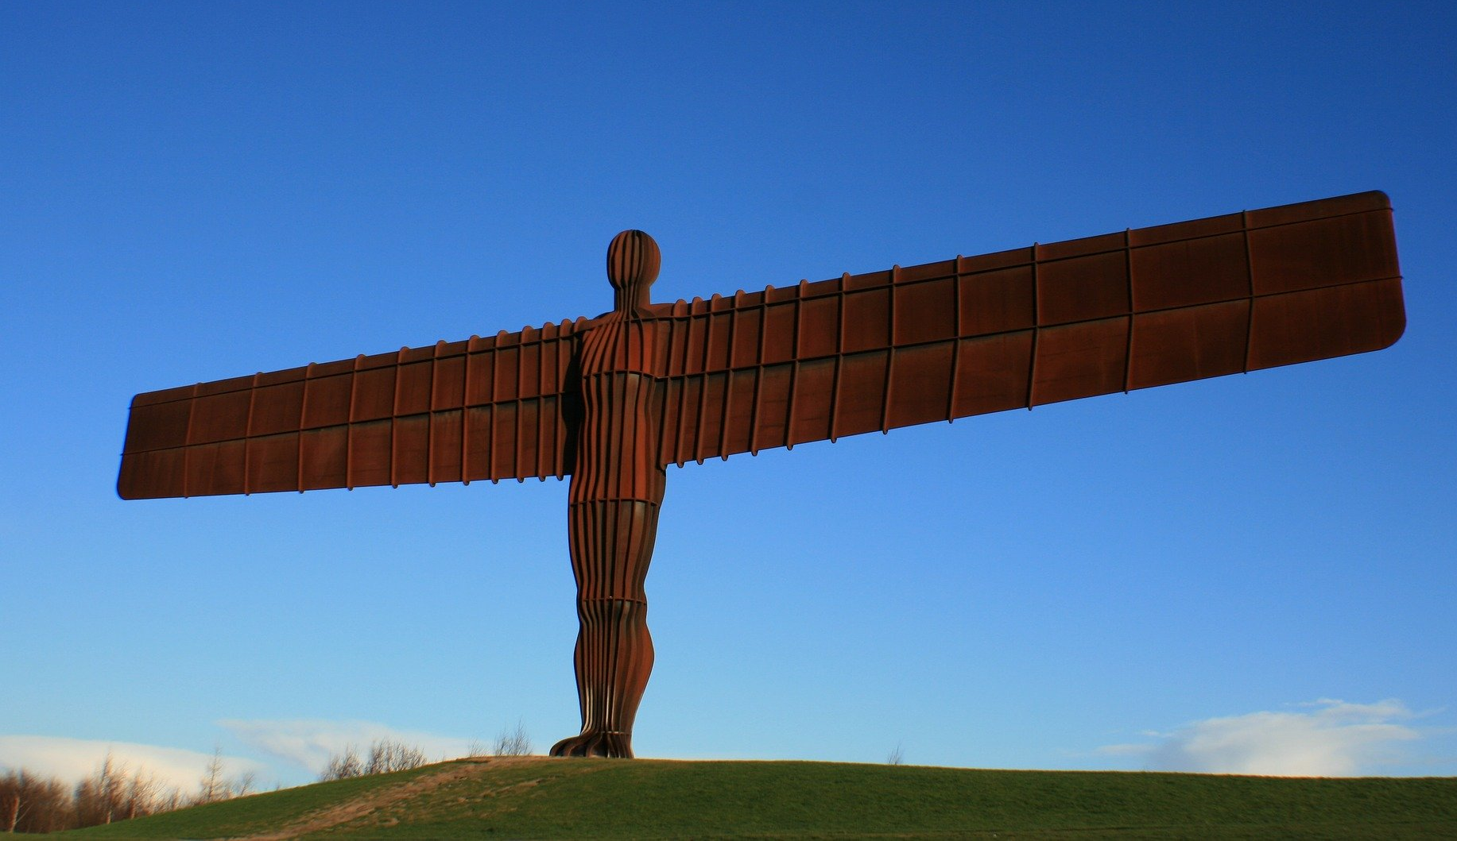
Famous Landmarks
Angel of the North,
Gateshead, UK

Slide 8
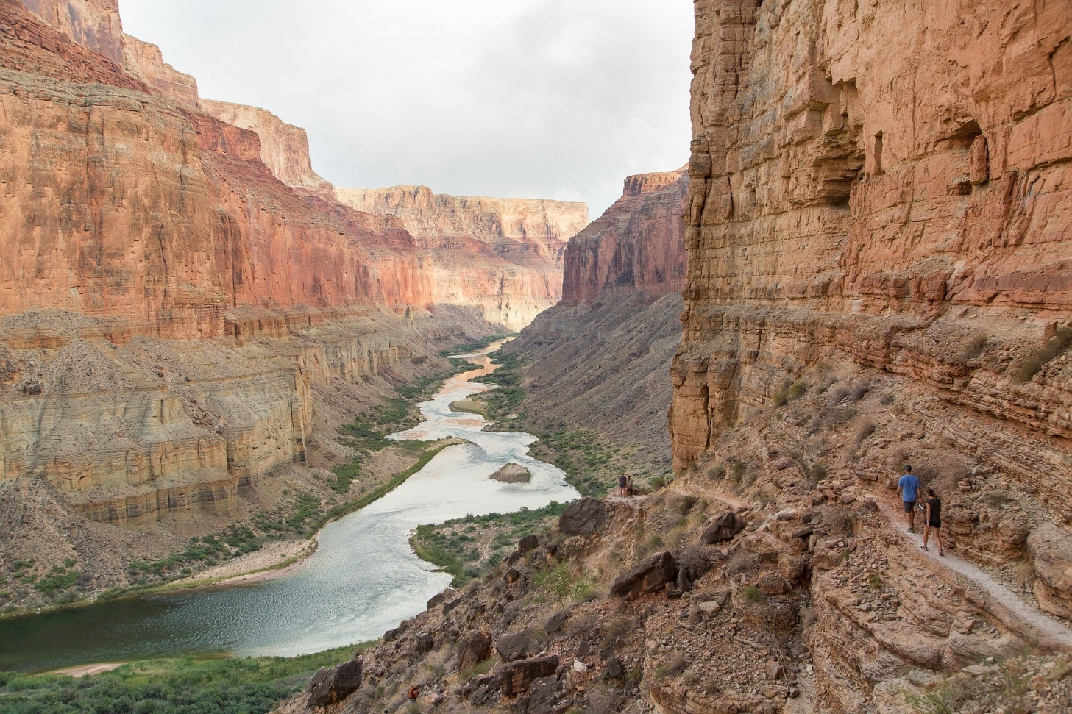
Famous Landmarks
Grand Canyon, USA

Slide 9
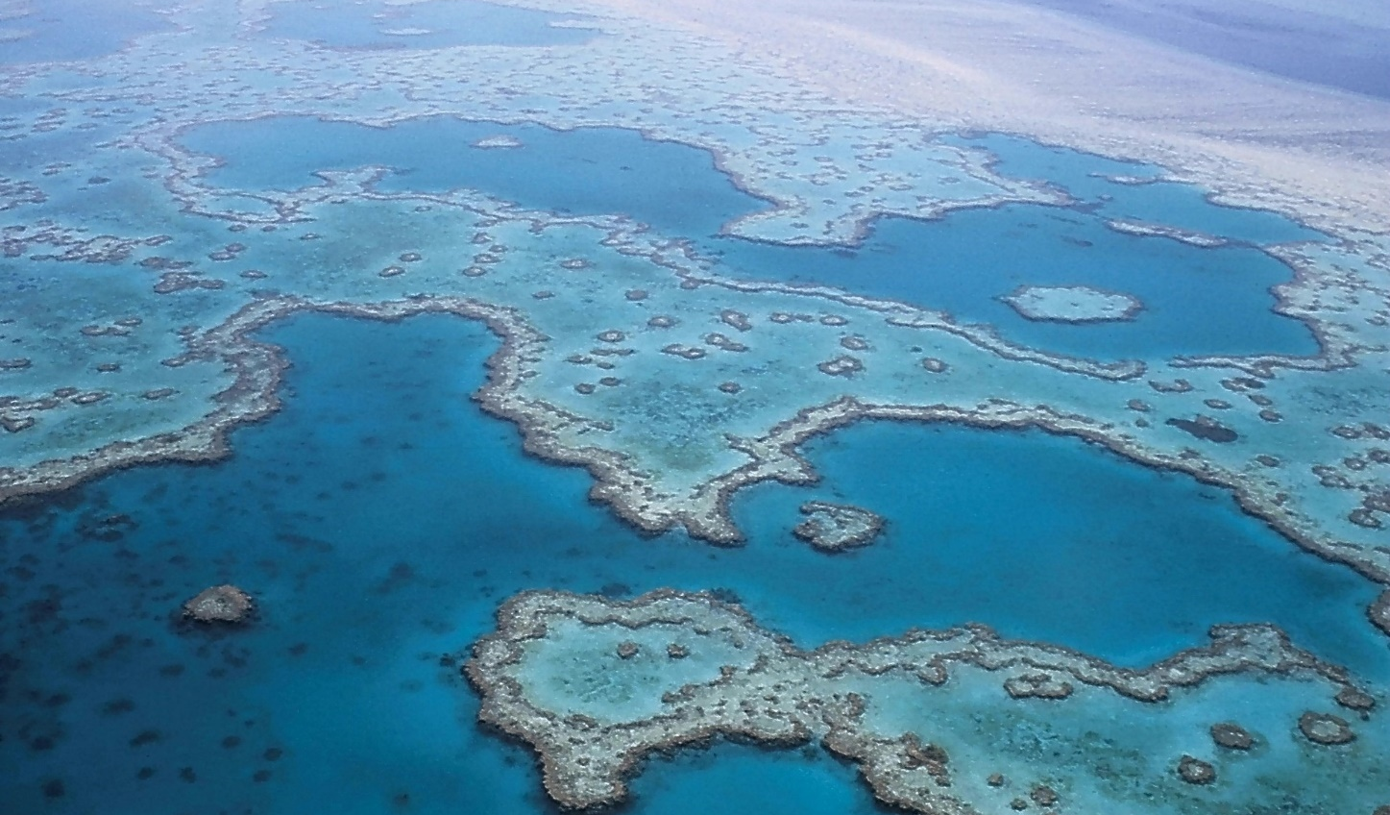
Famous Landmarks
Great Barrier Reef, Australia

Slide 10
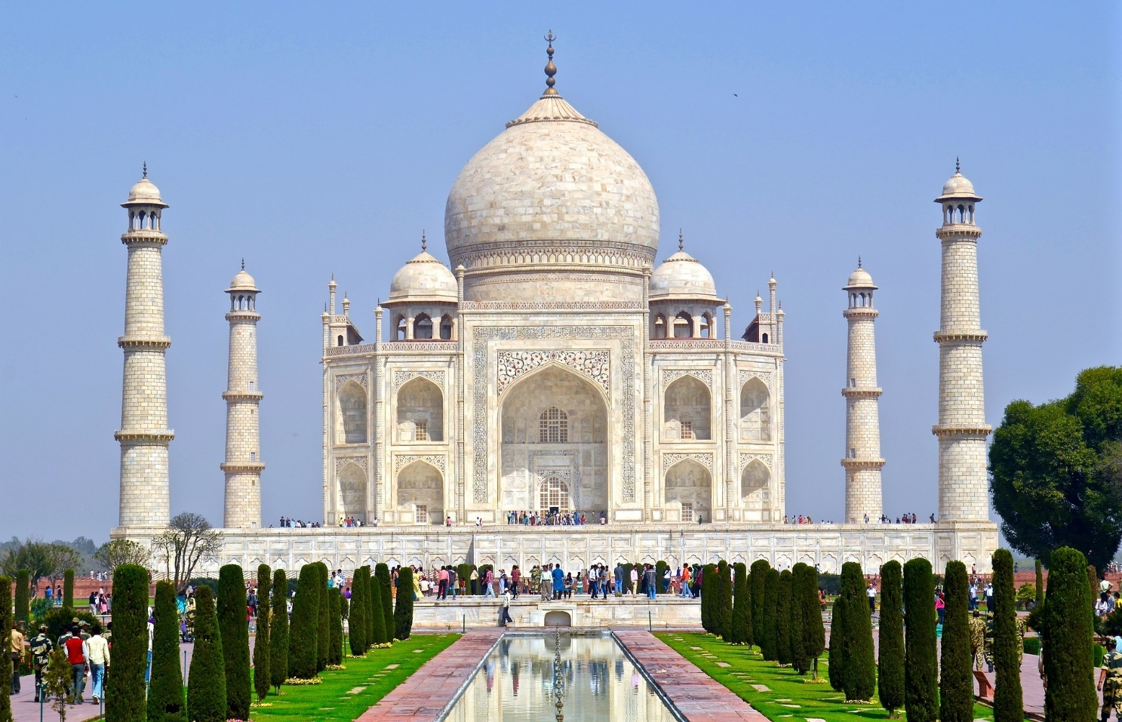
Famous Landmarks
Taj Mahal, India

Slide 11
Where Do You Live?
Here is a map of the
United Kingdom.
Can you find where you live on the map?

Slide 12
Tourists
Those silly No Jetters are talking about ‘tourists’.
I don’t even know what that word means!
Do you?

Slide 13
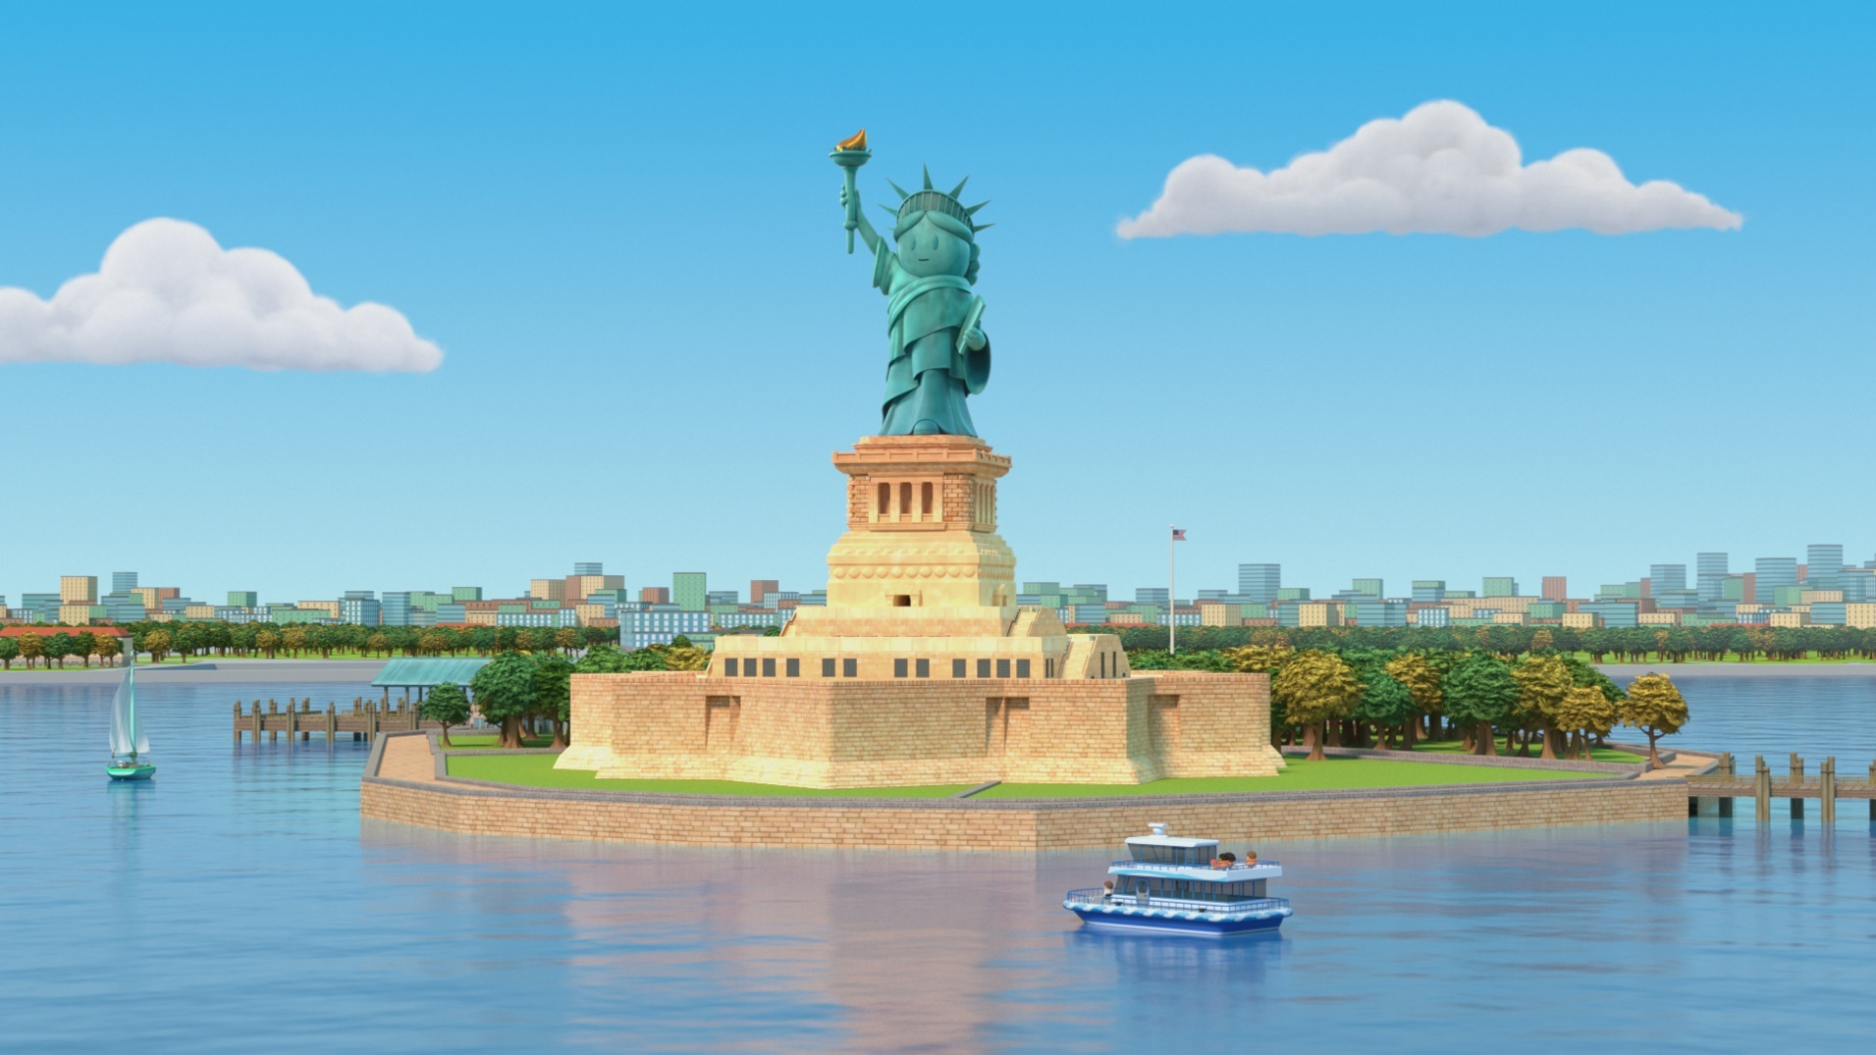
Tourists
Grandmaster Glitch hasn’t been paying attention again!
A tourist is someone who visits another place. They might visit for a few hours, a day, a week or longer!

Slide 14
Tourists
What places have you visited?
Did you see any landmarks?
What did you think
of them?

Slide 15
UK Landmarks
The UK has some really amazing landmarks. Let’s find out about some of them! You may have seen pictures of them. Maybe you’ve even visited one of these landmarks.
Loch Ness, Inverness-shire, Scotland
Giant’s Causeway, County Antrim, Northern Ireland
Caernarfon Castle, Gwynedd, Wales
Tower Bridge,
London, England

Slide 16
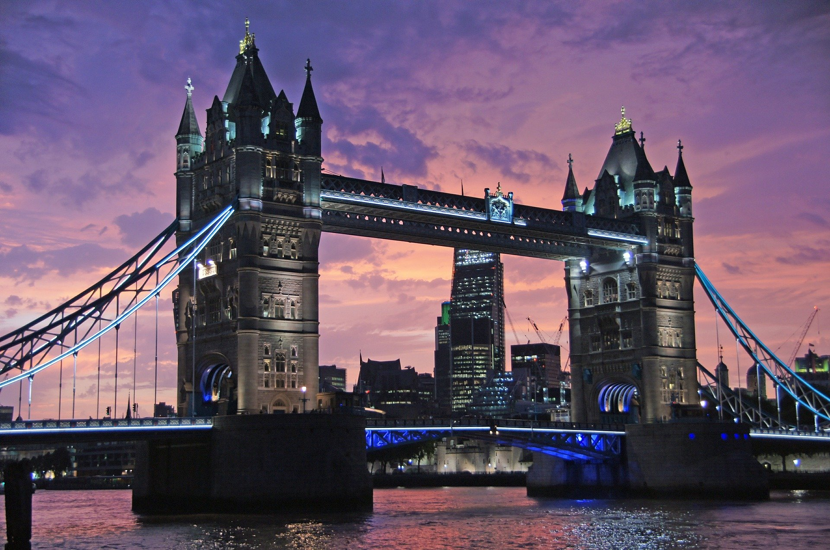
Tower Bridge
This is Tower Bridge in London, England. Here are Ubercorn’s Funky Facts about it.

Slide 17
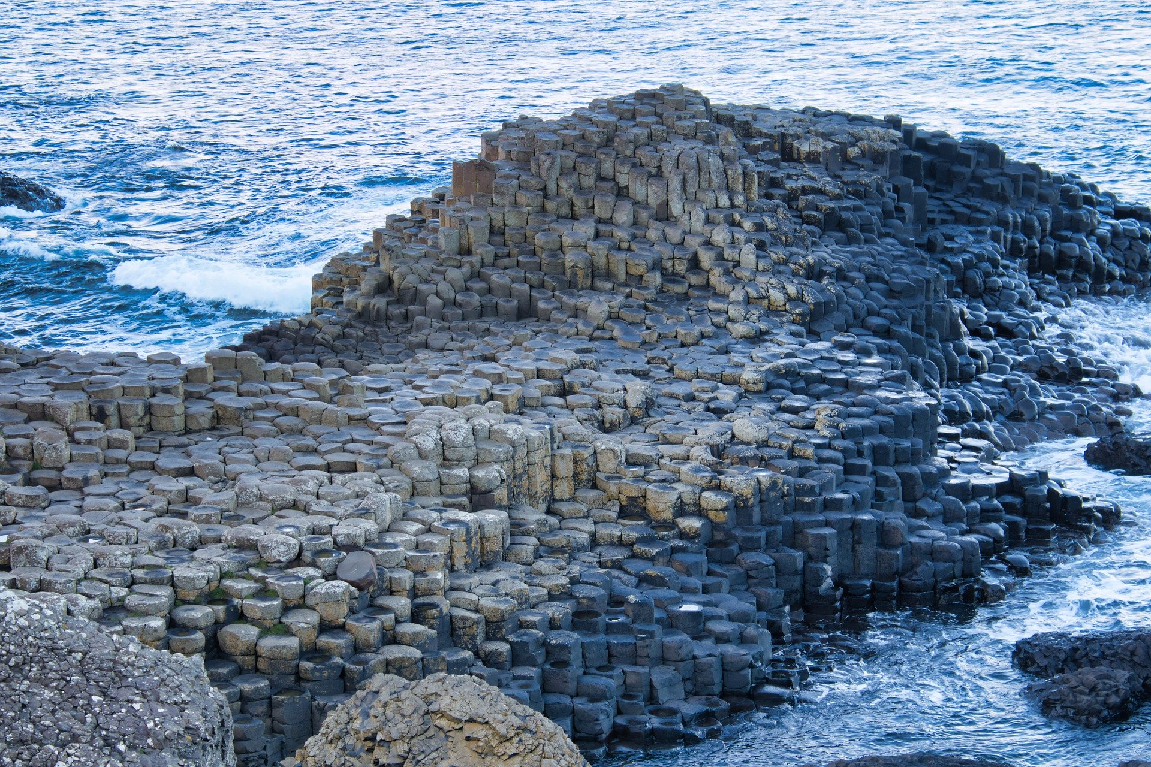
Giant’s Causeway
Giant’s Causeway is in Northern Ireland.
Let’s hear some Funky Facts about it!

Slide 18
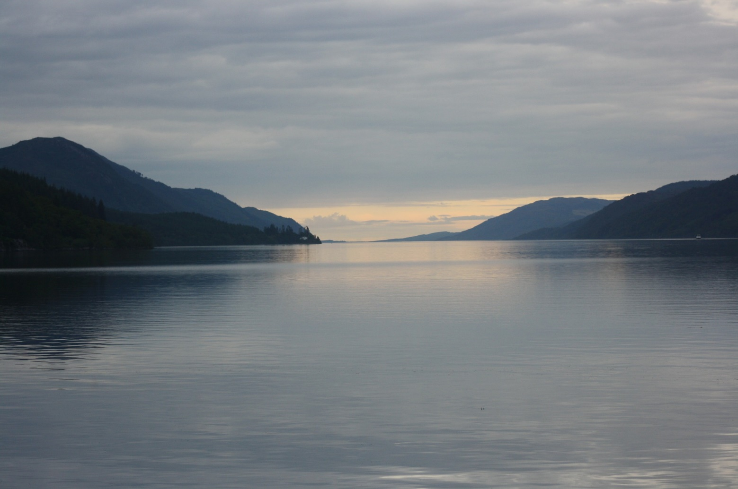
Loch Ness
Loch Ness is in Scotland. ‘Loch’ is a Scottish word for ‘lake’. Let’s listen to Ubercorn as he tells us about Loch Ness and the rumour about who might live there.

Slide 19
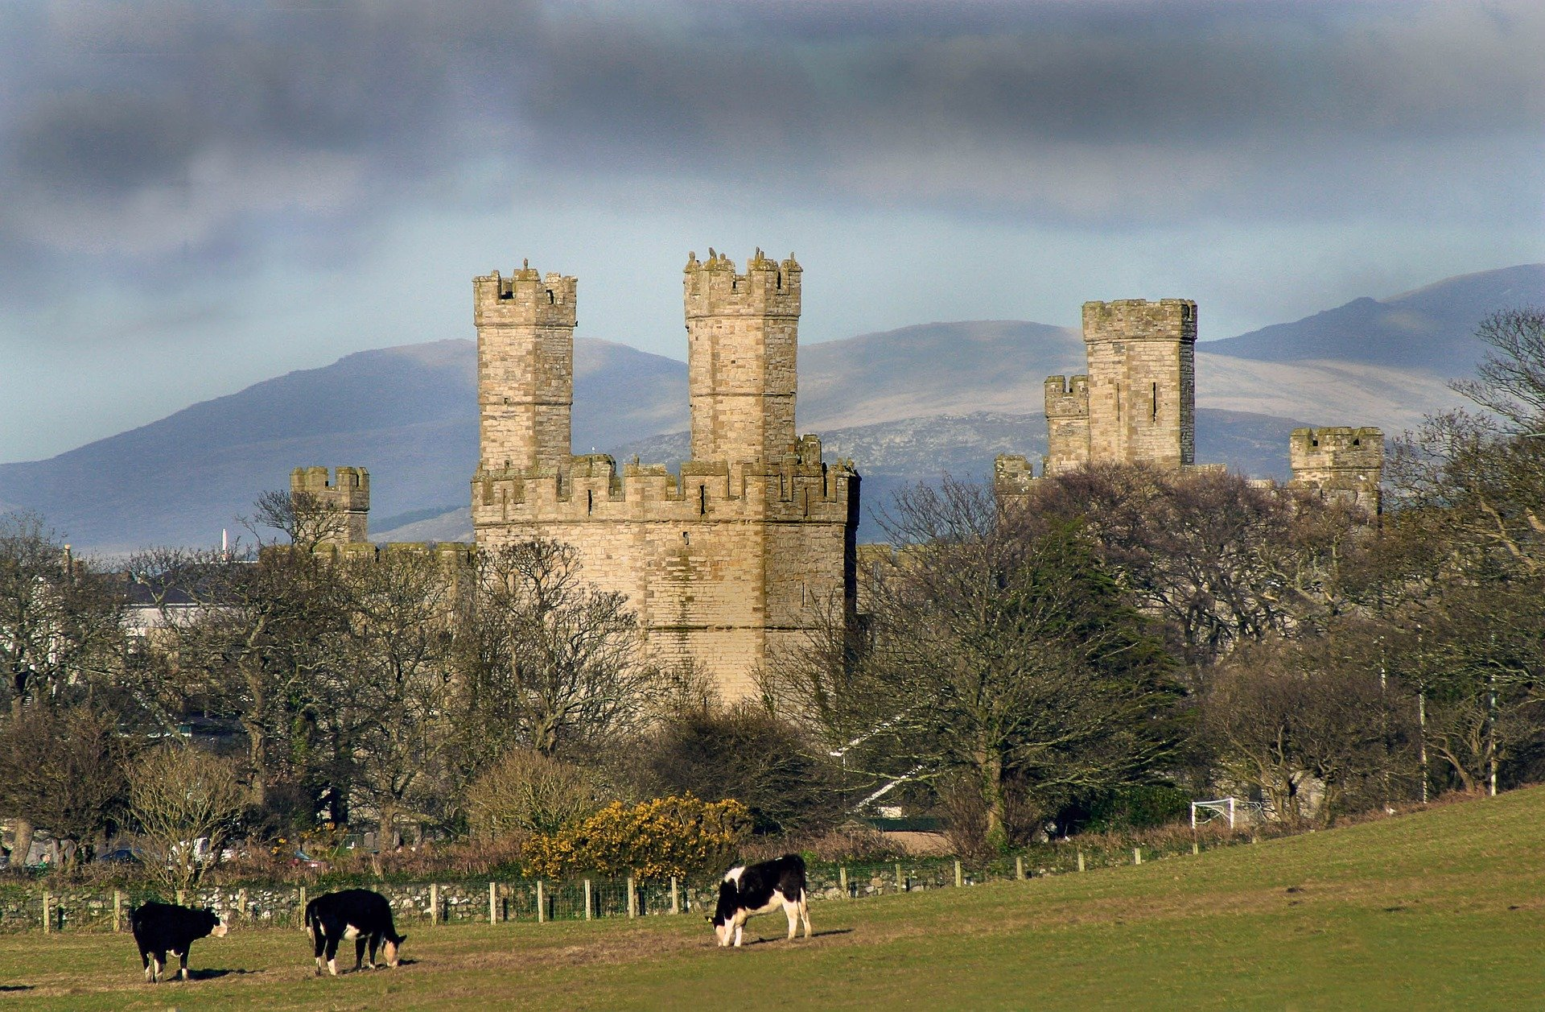
Caernarfon Castle
Caernarfon Castle is in Wales.
Here are Ubercorn’s top three Funky Facts about it.
Notes:
After watching the programmes, try some of the brilliant tasks suggested on the web page. https://www.bbc.co.uk/teach/class-clips-video/pshe-eyfs-ks1-go-jetters-uk-places-and-landmarks/zkyjkmn

Slide 20
Explore Some More
You are going to find out more about landmarks and maps.
Maybe soon you can join us and become a
Go Jet Cadet!

Slide 21
