Slide 1
angry
frightened
excited
speaker
sabre
protest
vote
Soldier
Peaceful
Do you know the meaning of any of these words? Are any words new to you?
Tell your partner.
Notes:
THIS IS 2 OR 3 LESSONS – 3RD COULD BE SOURCEWORK, SUFFRAGETTE WS, VIDEO, MORE ON PETERLOO – DRAMA?
See Minds and Machines book

Slide 2
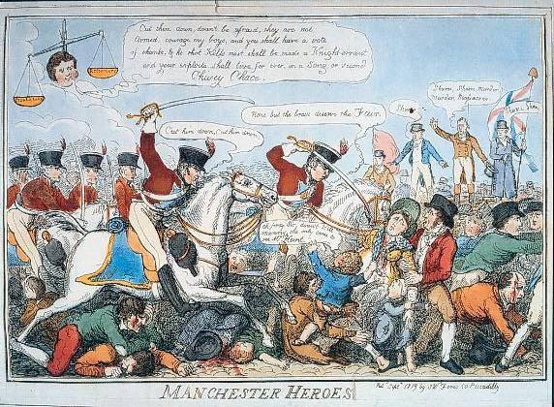
What is the story behind this picture?
You have a copy of this – answer the questions on the sheet

Slide 3
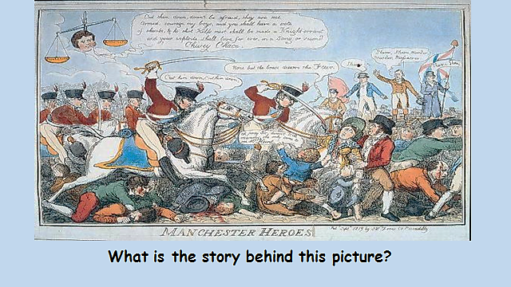
What do you think is happening? Can you explain why you think that?
What can you see? e.g. Horses
Notes:
With this picture – get the pupils to focus on specific examples, swords, men, women, hats, blood, flags, floating head, scales,

Slide 4
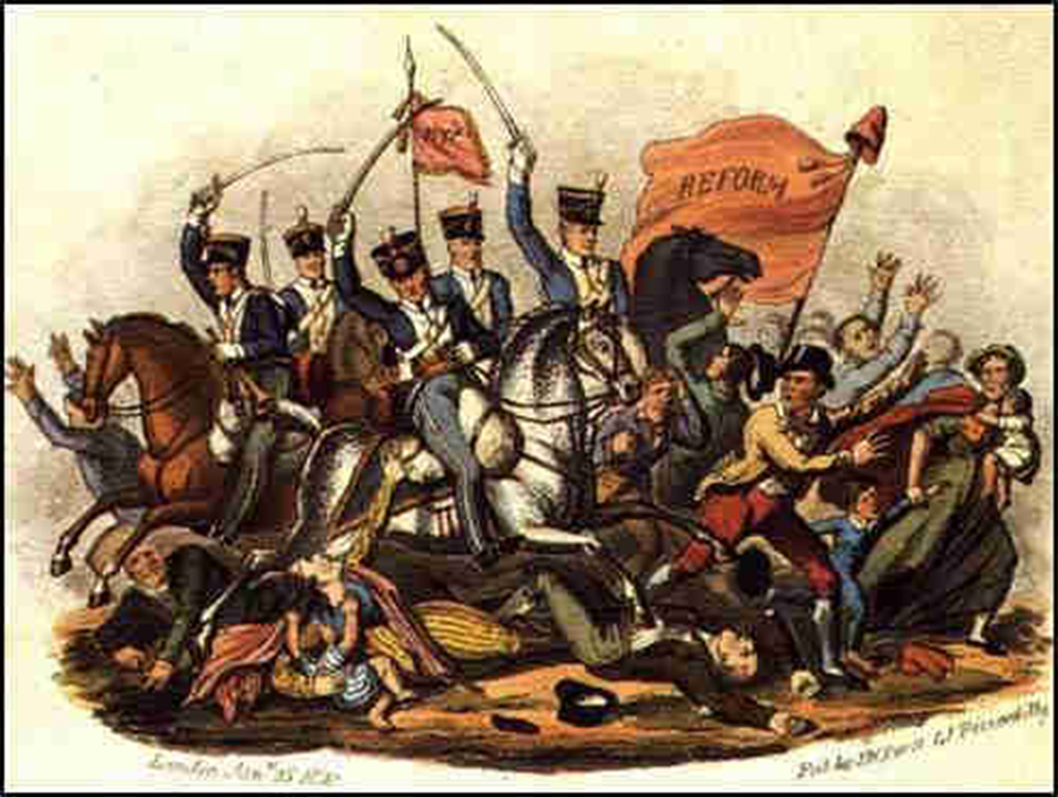
What was the Peterloo Massacre?
LO: to identify and describe what happened at St Peter’s Fields in Manchester.
Key Words
Yeomanry – local volunteer soldiers, brought together to keep the peace
Cavalry – soldiers on horses
Sabres – type of sword with a curved blade

Slide 5
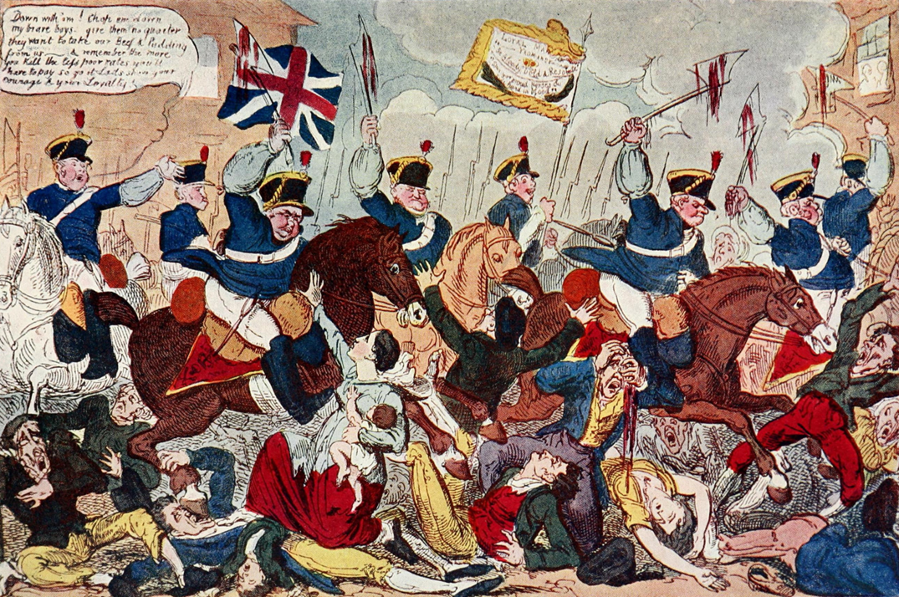
https://www.youtube.com/watch?v=I-ln4p4mWu0
Task 2
Write the questions down and leave space to answer. Watch the clip so you can answer the questions.
Why did people protest in Manchester?
What did they want?
What did they not have?

Slide 6
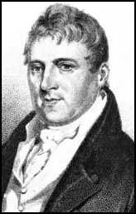
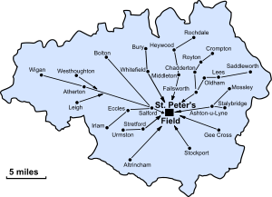
Henry Hunt – ‘Orator Hunt’
So what happened?
A map showing the routes that people marched from around Manchester to listen to Henry Hunt speak.

Slide 7
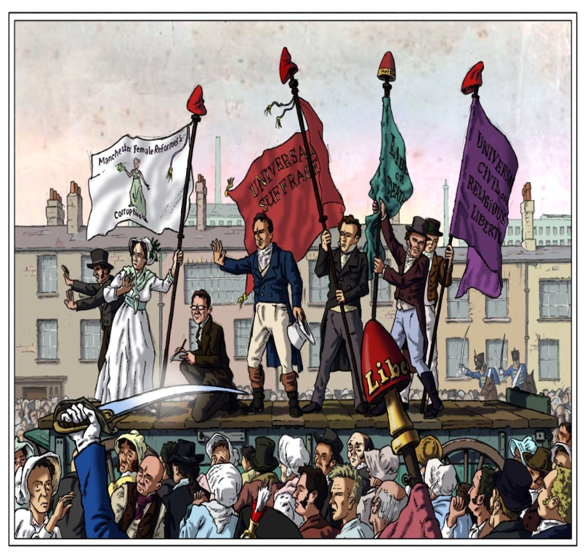
On the 16th August 1819, many people set out, in their best Sunday clothes, to protest for their rights. The government at the time didn’t like the idea of working men having rights and large groups of people protesting.

Slide 8
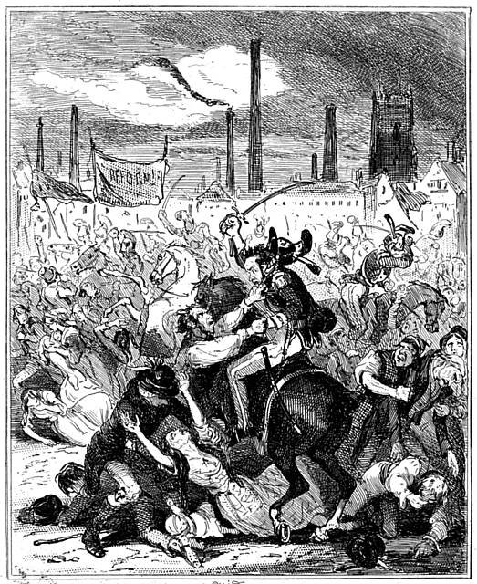
What went wrong?
Thousands of people gathered (around 60,000 to 80,000) in St Peter’s Field, Manchester. Fortunately, the march was peaceful. Henry Hunt had ordered the people to come unarmed. No one was carrying weaponry. Families came, including women and children.
The protest was peaceful and there was nothing there that could challenge the power of the authorities, except for the people. However, the authorities were worried.

Slide 9
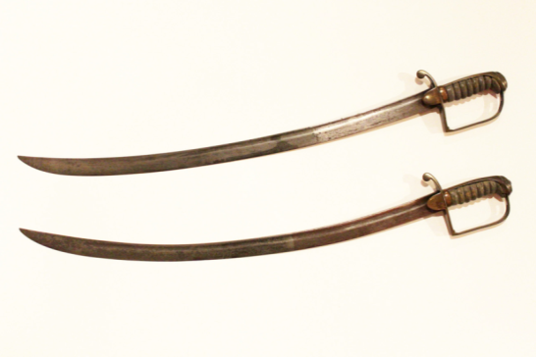
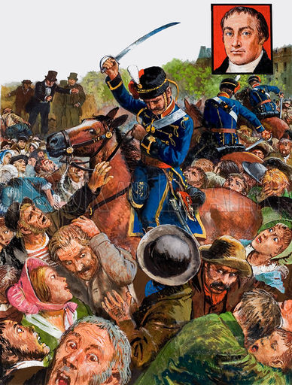
Men on horses (cavalry) barged through the dense crowd. Screams and yells echoed throughout the whole of Manchester as the soldiers, carrying sharp sabres, cut through the marchers.
It was thought the cavalry men were half drunk. They ruthlessly swished their swords at everyone, no matter their gender or age. Men, women and children lost their lives. If they weren't dead, they were brutally injured.

Slide 10
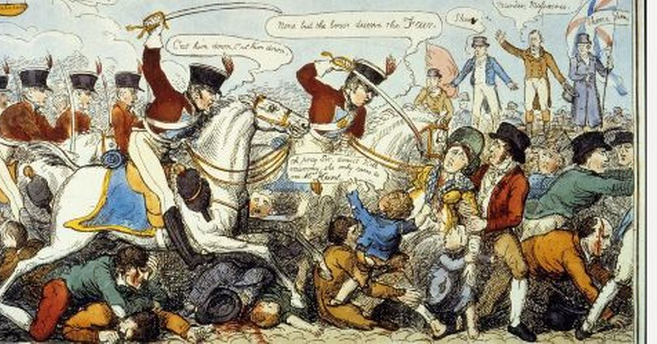
That day, was supposed to be a peaceful protest of campaigners gathered to persuade the government to give them the right to vote.
By the end of the day, no one had predicted that it would turn into a bloodbath. 600 were injured and 15 were killed, one being an innocent child.

Slide 11
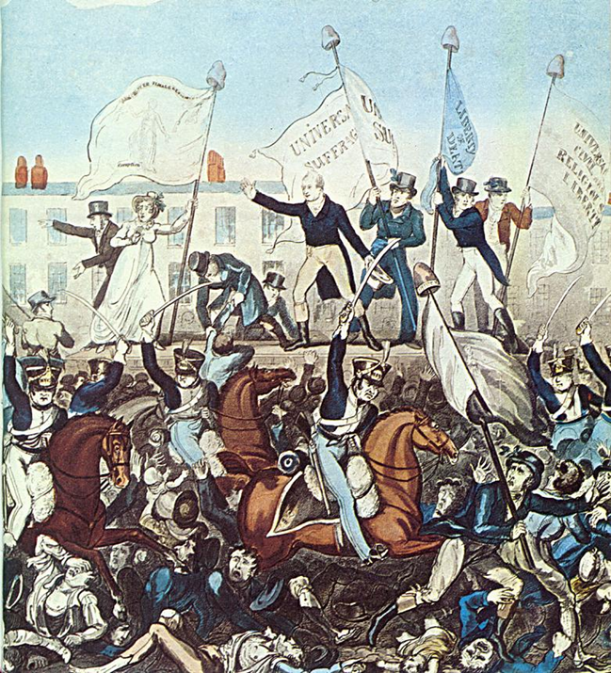
 | Henry Hunt spotted on the stage.
 | On the morning of 16th August 1819, a protest march begins from different areas around Manchester
 | The field is strewn with the dead and the injured. 15 people died, with approx. 600 injured.
 | The marchers arrive at St Peter’s Field for the mass public meeting and to listen to Henry Hunt and other reformers.
 | The magistrates order the yeomanry to arrest Henry Hunt. The yeomanry then draw swords and hacked through the crowd.
Task Two – In pairs - Put these in the correct chronological order

Slide 12
3 | Henry Hunt spotted on the stage.
1 | On the morning of 16th August 1819, a protest march begins from different areas around Manchester
5 | The field is strewn with the dead and the injured. 15 people died, with approx. 600 injured.
2 | The marchers arrive at St Peter’s Field for the mass public meeting and to listen to Henry Hunt and other reformers.
4 | The magistrates order the yeomanry to arrest Henry Hunt. The yeomanry then draw swords and hacked through the crowd.

Slide 13
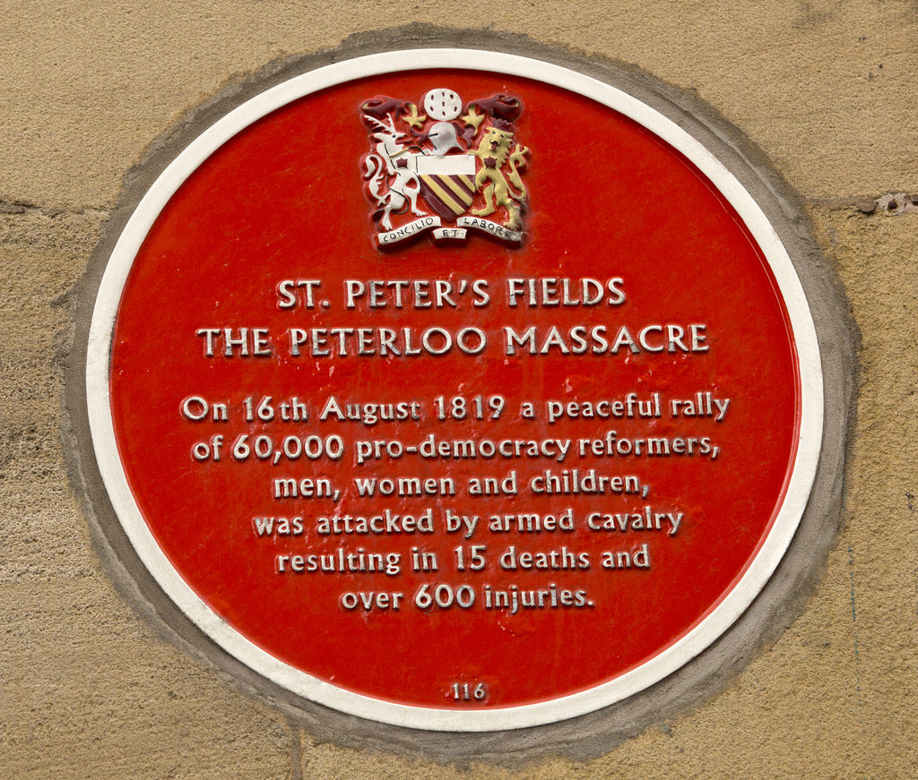
This is a plaque that you can see on the side of the Radisson Hotel in Manchester.

Slide 14
How did it feel to be there?
angry
frightened
excited
speaker
sabre
protest
massacre
Vote
Soldier
Peaceful
Task 3 - Can you write your own story – what could we include.?
Try to use the words that we looked at in the beginning.
I came here to listen to the….
We wanted…
The soldiers began to……
I felt…
I will always remember this day because….

Slide 15
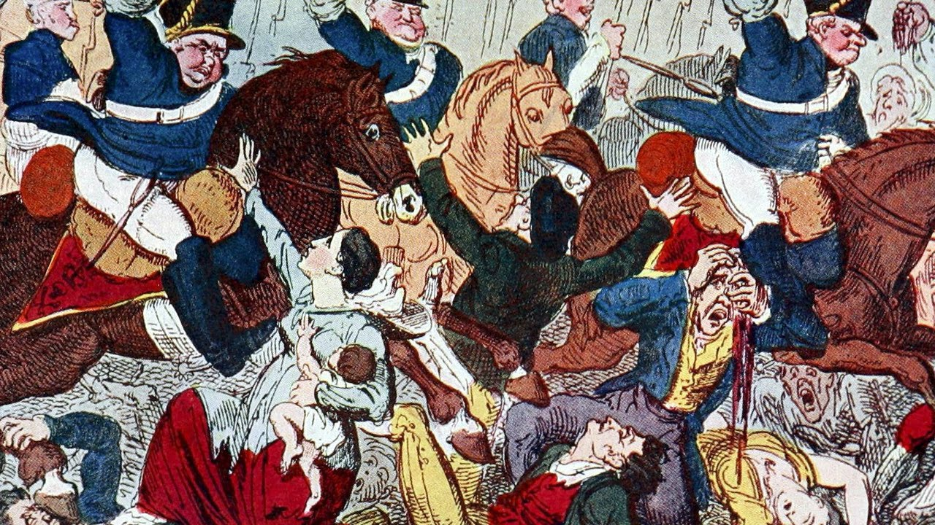
Quiz

Slide 16
Beat Your Teacher

Slide 17
What was the date of the Peterloo Massacre
16th August 1819
⁼

Slide 18
In which city did Peterloo take place?
Manchester
⁼

Slide 19
Why were people protesting in Manchester? What did they want?
The Vote!!!
⁼

Slide 20
How many people gathered at St Peter’s Fields?
60,000 to 80,000
⁼

Slide 21
Who was the leader of the protesters?
Henry Hunt
⁼

Slide 22
How many were injured?
600
⁼

Slide 23
How many died?
15
⁼

Slide 24
What was the name of the weapon used by the cavalry
sabres
⁼

