Slide 1
Spanish Quiz flash cards
Spanish 101

Slide 2
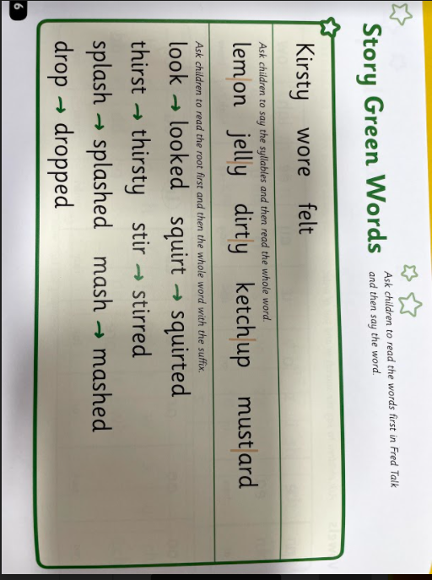
QUICK TIP
Try right clicking on a photo and using "Replace Image" to build your own flash cards..
El perro

Slide 3
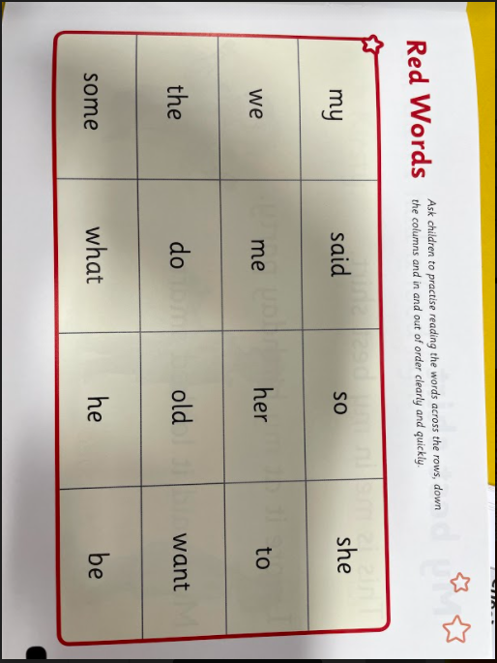

Slide 4
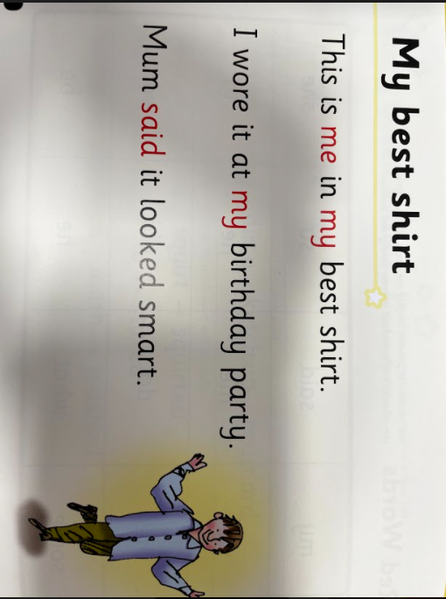
La piña

Slide 5
La silla

Slide 6
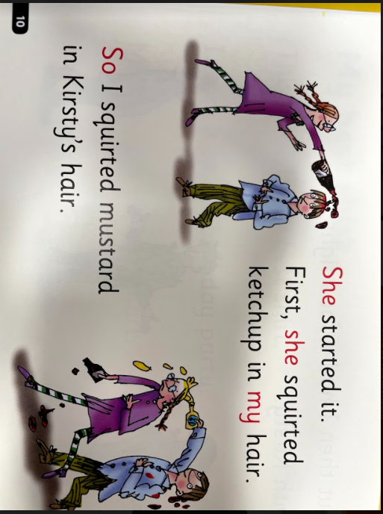

Slide 7
El coche

Slide 8
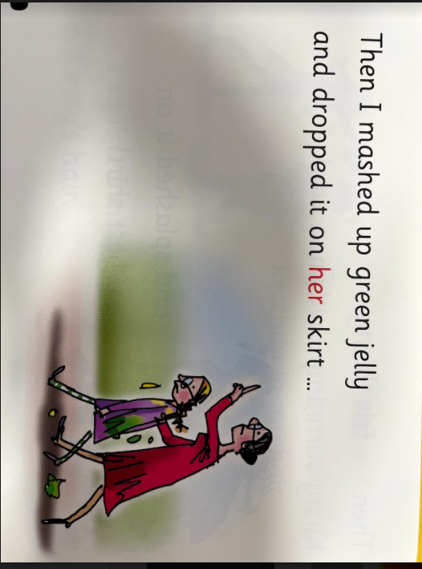
Bicycle

Slide 9
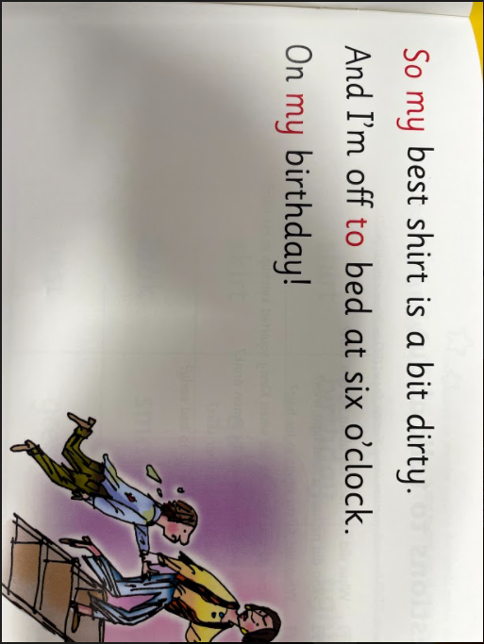
Bicicleta
Bicycle

Slide 10
