Slide 1
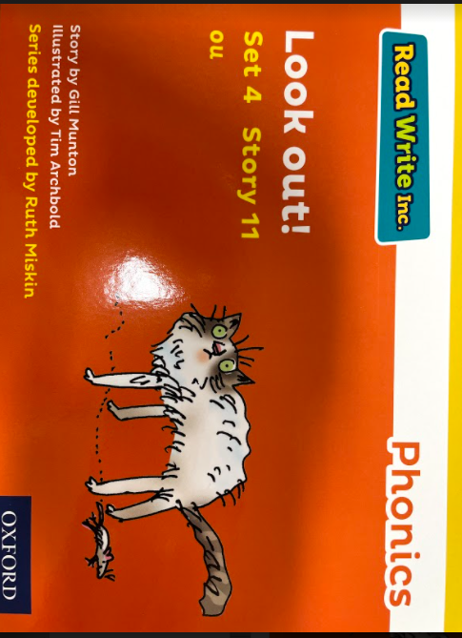
Look out!
Activity Book
Name: _______­­­­­­____________
Date: ___________________

Slide 2
Read and Draw
A mouse with pink feet and a sniffly snout!
It runs round the sink and it runs up the spout.
A mouse in my house.

Slide 3
True or X False
The mouse has a red feet.
The mouse has a tickly nose
Puss wants to pounce.
Mum is happy.
The mouse is very still and does not move.
The mouse runs around the bath.
The mouse is in the house.

Slide 4
Word search
m | o | u | s | e | y
h | a | f | n | l | s
c | s | h | o | u | i
u | r | u | u | p | n
o | c | w | t | t | k
p | o | u | n | c | e
mouse snout pounce
ouch sink

Slide 5
Answer these questions
What has come into the house?
What did puss want to do?
What did the mouse run round?
How would you feel if you had a mouse in your house?

Slide 6
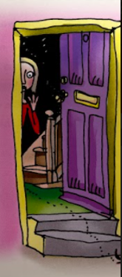
What happens next?

