Slide 1
Asking your child to do school work during this time is very challenging. Here are some practical, fun activities, I hope will support you and be enjoyable for you to do at home. There are also some reading and writing activities for you to have a go at. In this pack, I have included a feelings chart which we use in school to help discuss feelings during this current time.
We hope you are safe and well, we miss you very much.

Slide 2
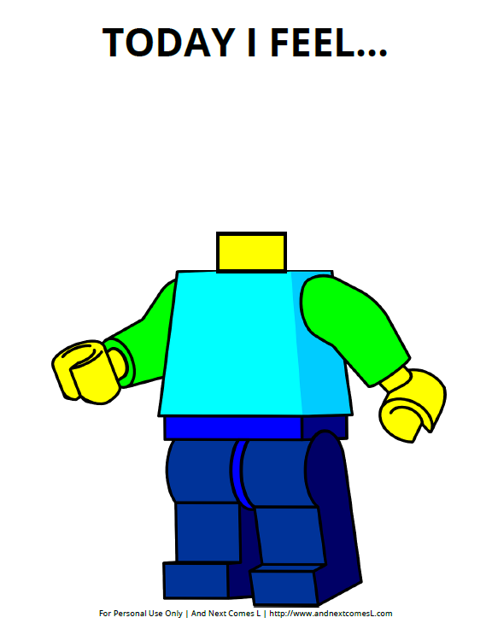

Slide 3
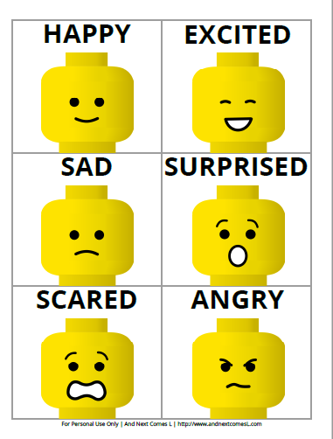

Slide 4
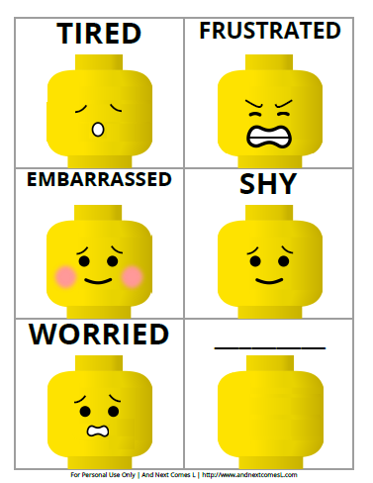

Slide 5
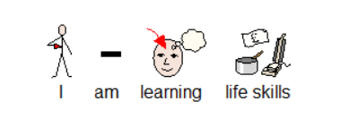
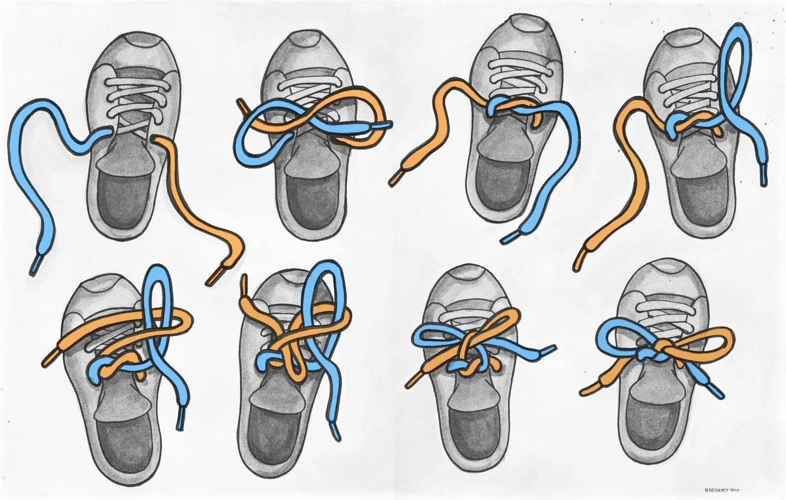
Setting the table.
Washing Windows/Washing Car Working with a spray bottle or soap and water is always fun! Washing is a practical life activity
Tying Shoes. It is tremendously practical to learn how to tie my own shoes.
Learning to prepare a snack using a knife. Preparing my own snack is a practical life activity, this will give me a splendid sense of accomplishment.
Taking measurements. Use hands/feet to measure the length of table’s chairs/ use a ruler to measure things around the house. Use cm/mm measurements and learn what these units of measurements are. I can compare heights!

Slide 6
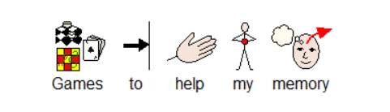
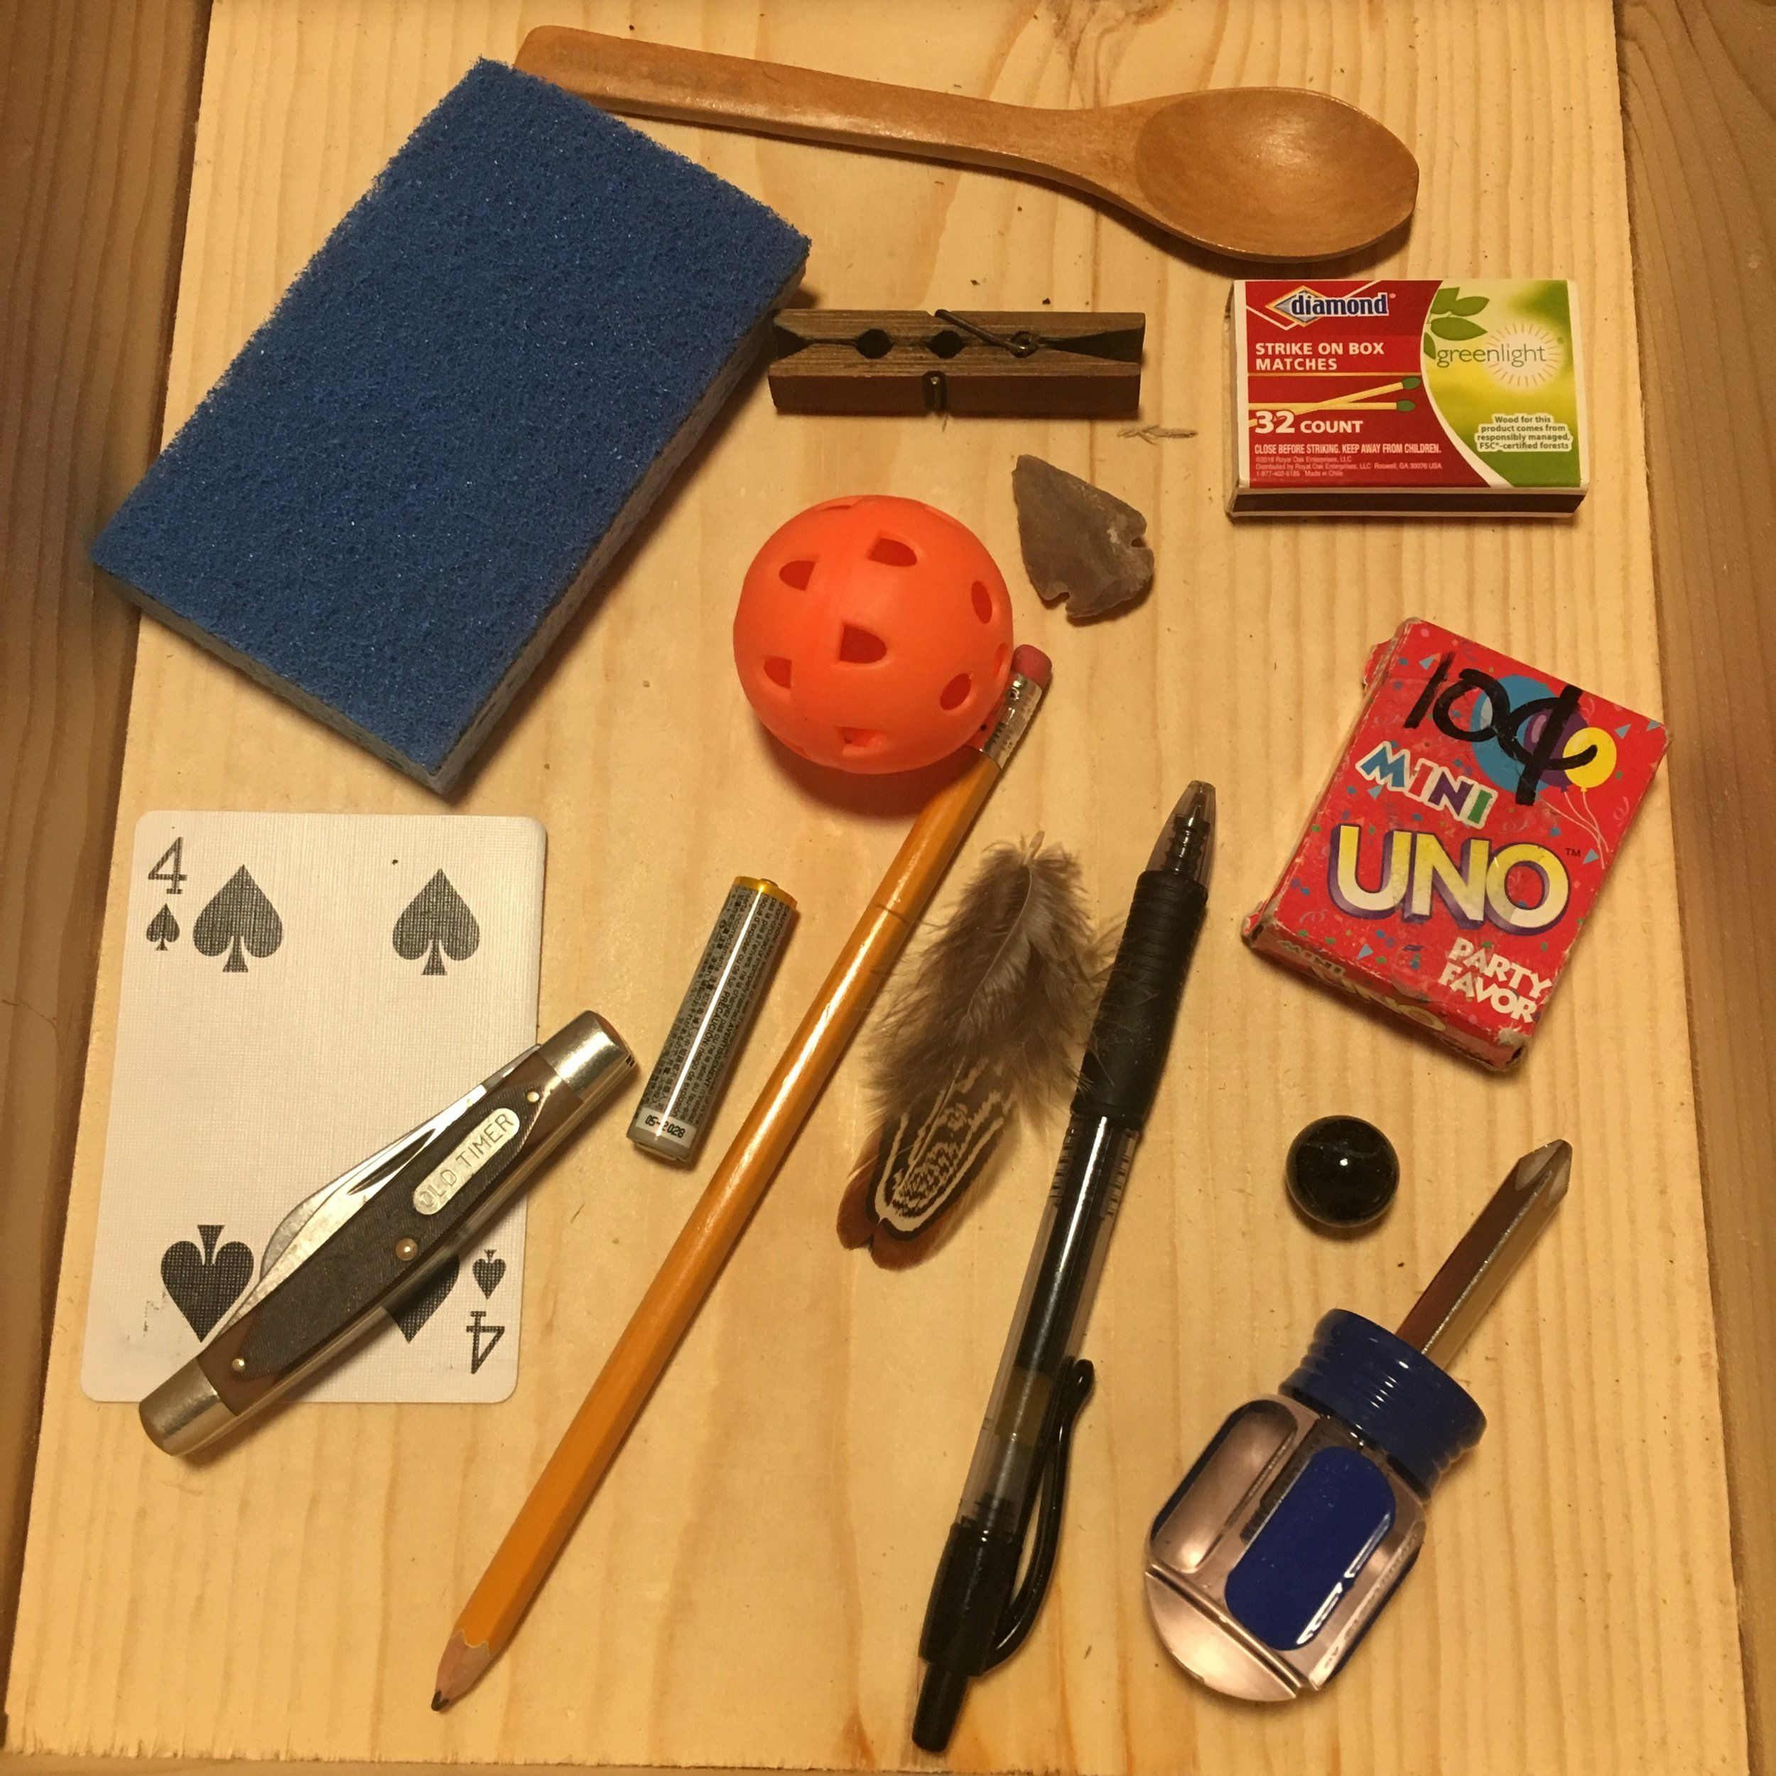
Tray Games
Put a number of objects on a tray or table. Name each object. Cover the tray with a cloth then remove an object. Your child has to say which object has been removed. Or ask your child to say, write or draw how many objects they remember.
Patterns
Show your child three objects, letters or shapes in a row. Cover the objects and ask your child to copy the pattern from memory. Increase the number of objects as they get more confident.
Pairs
Have a number of pairs of pictures or cards face down on the table. You take turns to turn over 2 cards. If they match you win that pair. The winner is the one with the most pairs. (see next page for pairs cards)
Mrs Martin
“Mrs Martin went to the market and brought…” Each person takes turns to recall the previous objects bought and add their own. Try building on your child’s interests e.g. “Scooby Doo went to the kitchen and ate….”
Odd one out
Say a list of items that are linked with one odd one. Ask your child to pick the odd one. E.g. “apple, banana, table, pear, strawberry.”

Slide 7
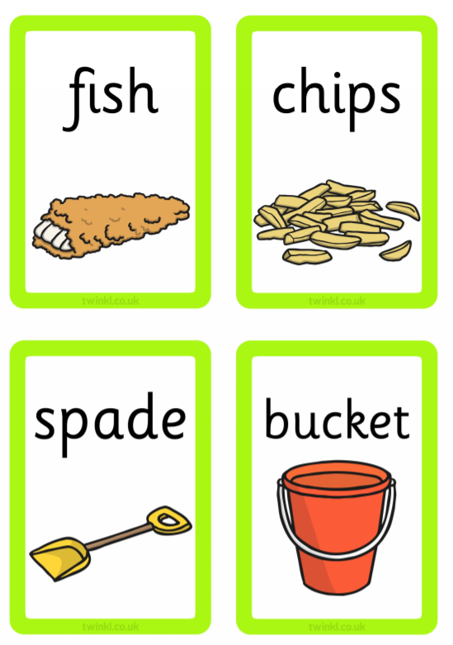
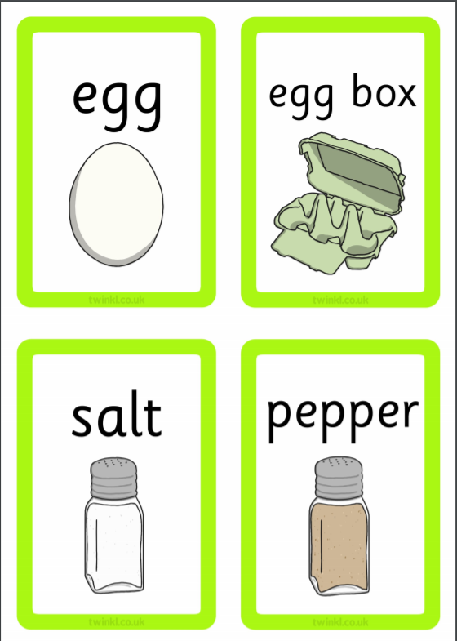

Slide 8
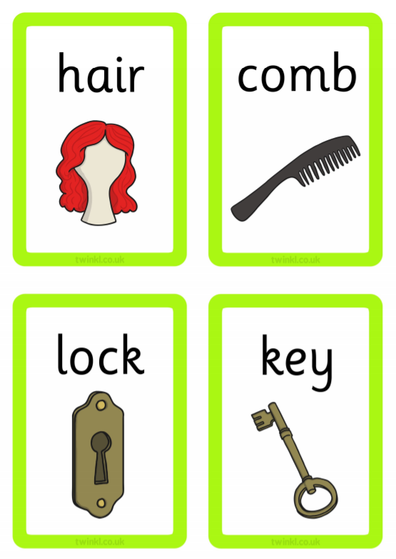
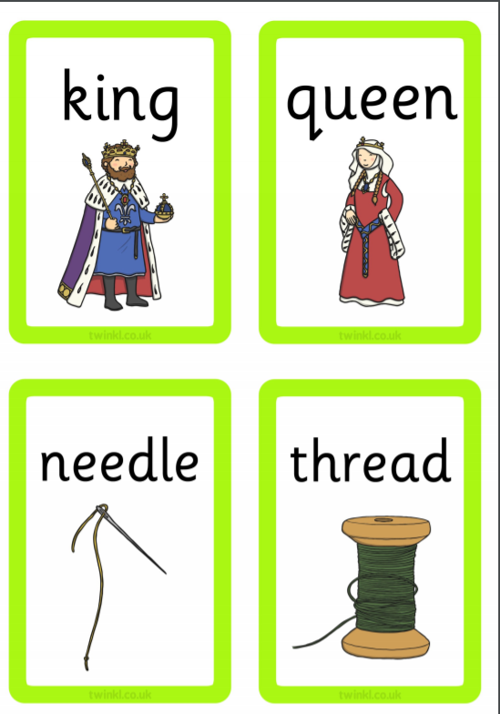

Slide 9
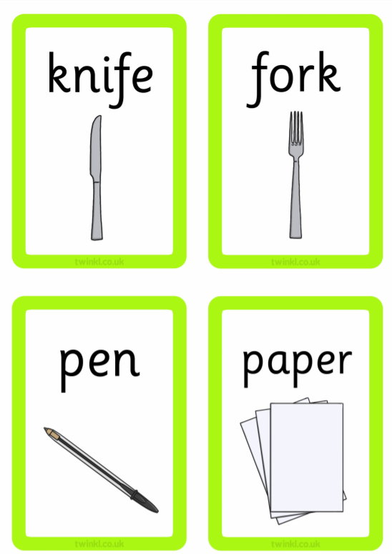
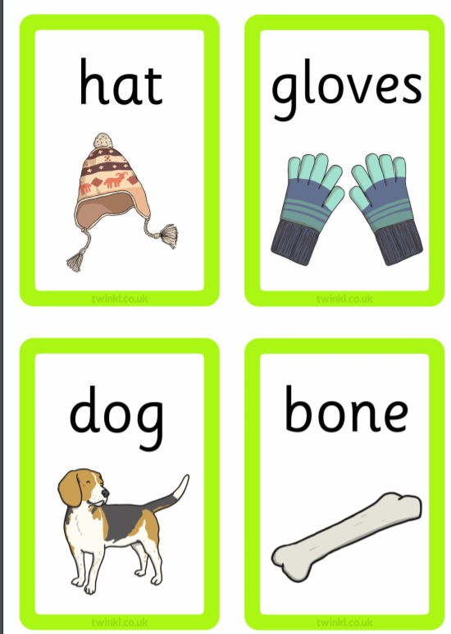

Slide 10

Indoor
Read the clues to your child and see if they can work out the items.
I have four legs, but I don't have feet.
I come in handy when it's time to eat.
My job is to put an end to sleep,
Which I do with music, a buzz, or a beep.
For fast heating or cooking, I am tops.
And, oh, that good smell when my popcorn pops!
I'm packed really full of boxes and cans.
I may hold a broom or a mop or a dustpan.
I can take you to places you've never seen,
But first, type your password in on my screen.
I rain on you when you need a scrub.
I'm very much like my friend the tub.

Slide 11
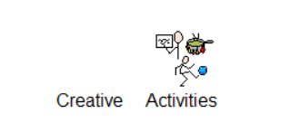
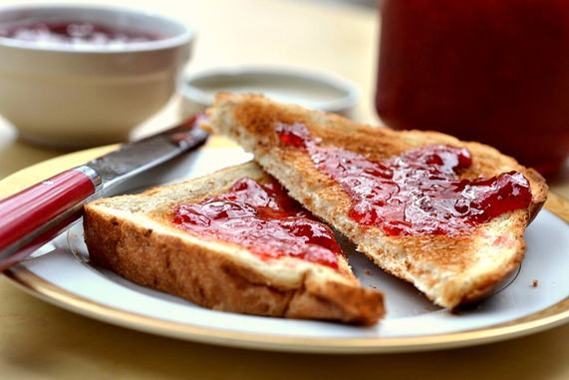
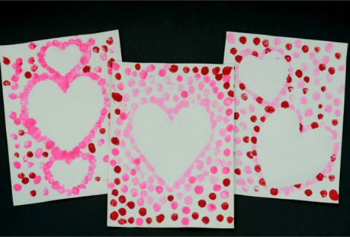
Can you draw or re-write your favourite story?
Can you make a card for someone in the Smart Room?
Draw what you can see out your window. Can you say and write what you can see in your picture?
Can you write all the letters of the alphabet? Can you form your letters the correct way?
Make toast with your favourite topping. Write instructions on how you did this.

Slide 12
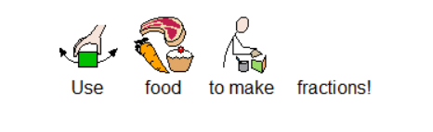
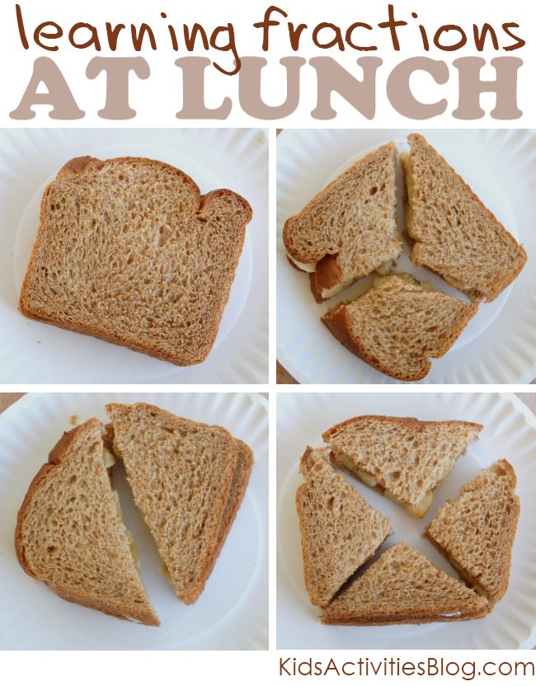
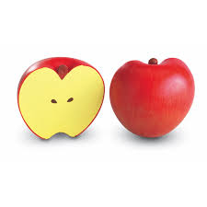
Use eating opportunities for Maths.
Ask your child to cut their food into half and quarters. See if they can use these words “half” and “quarter” in a sentence.
(Be safe when using a knife)

Slide 13
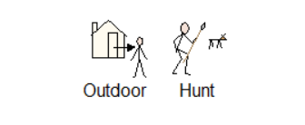
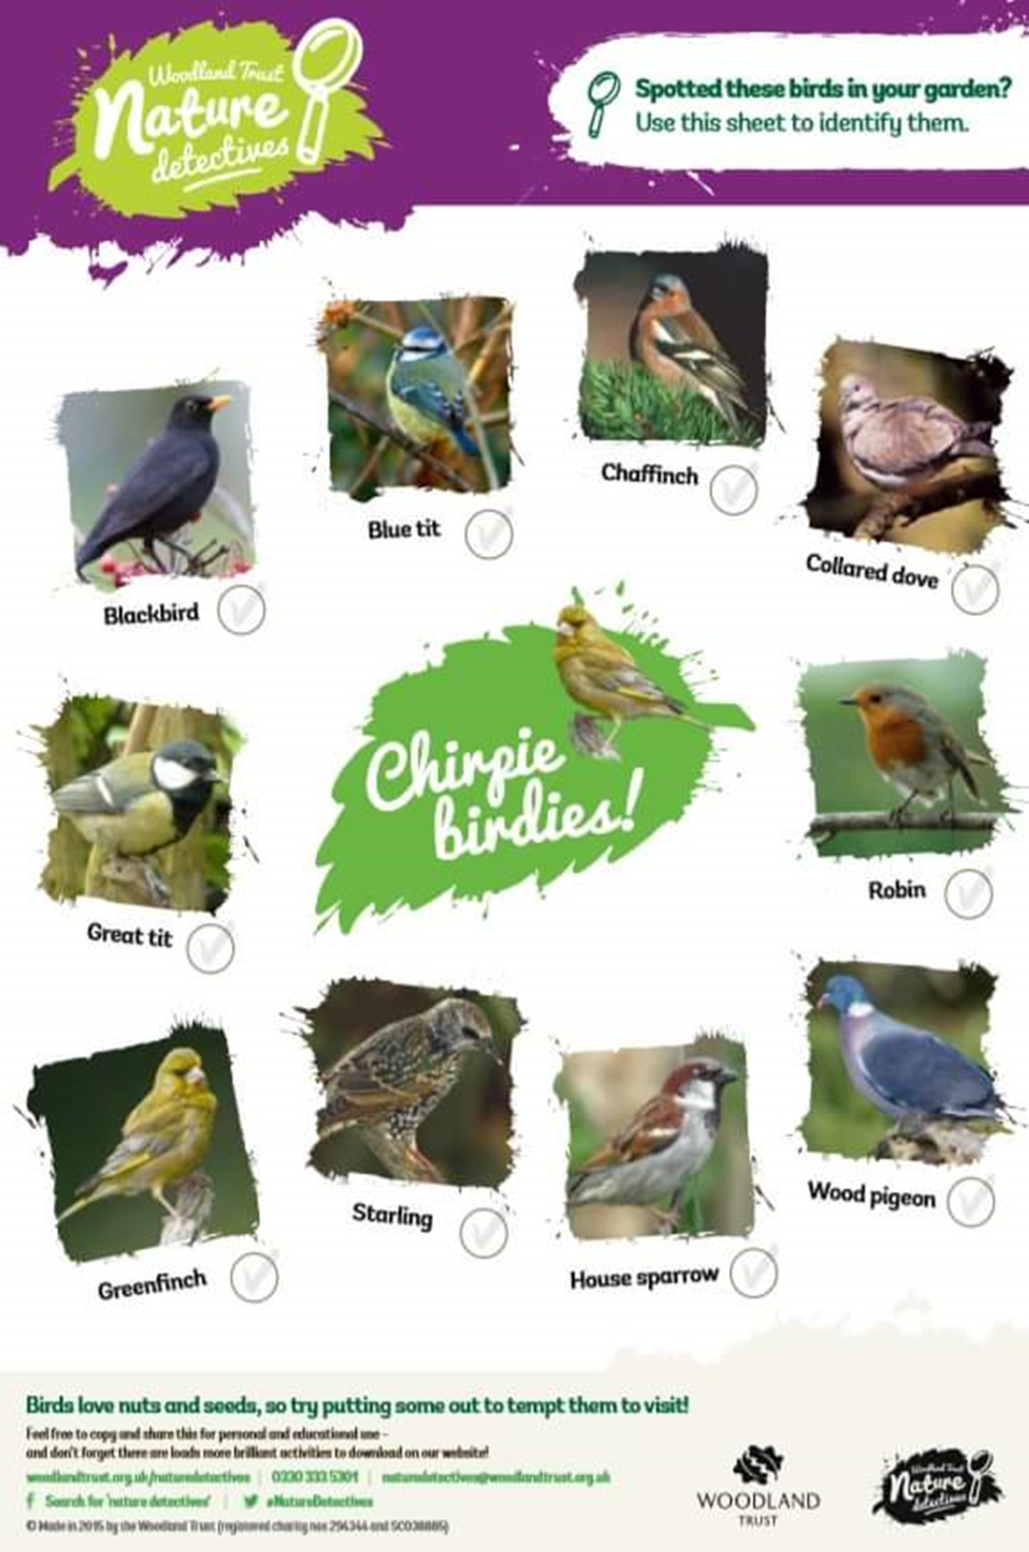

Slide 14
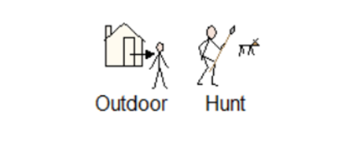
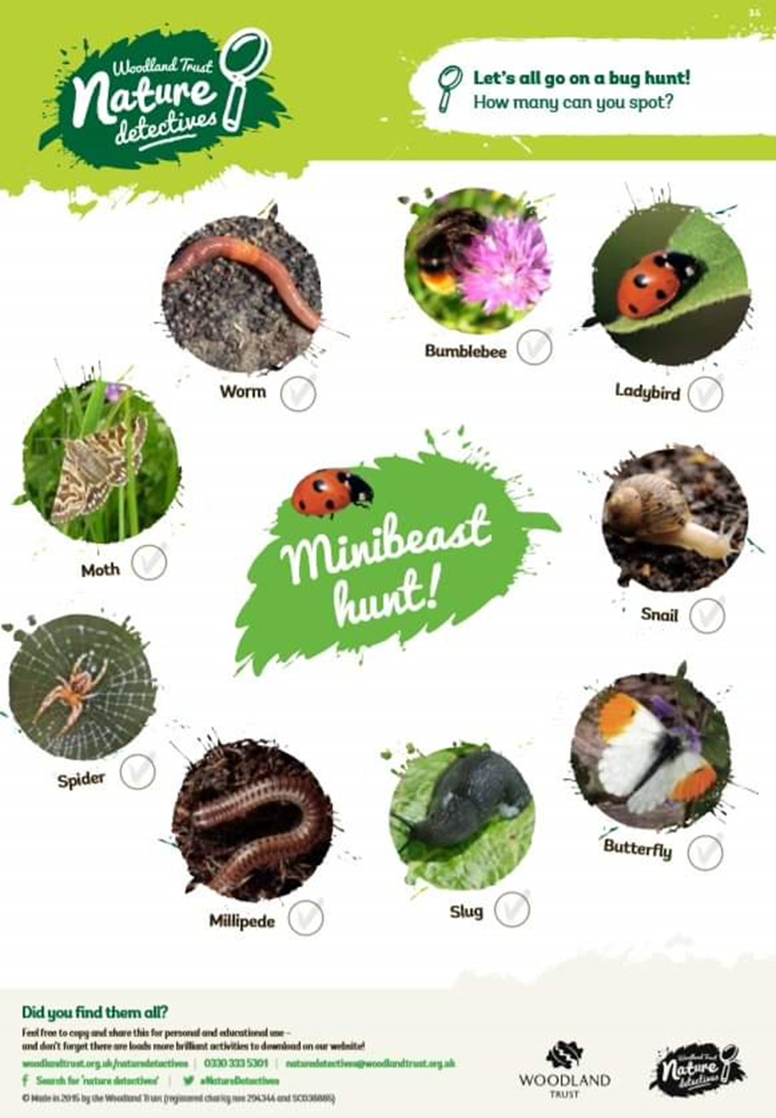

Slide 15
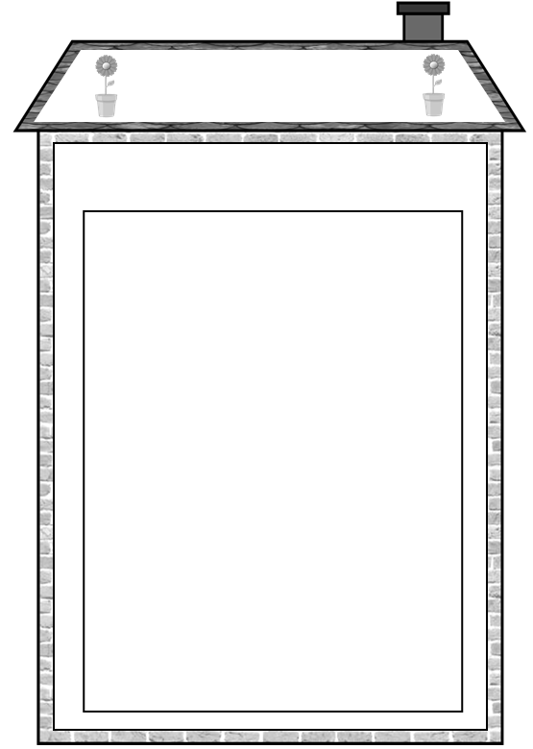
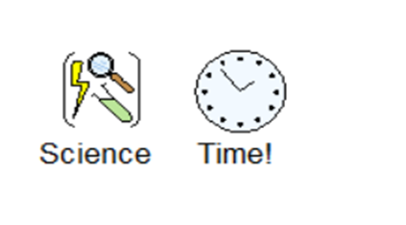
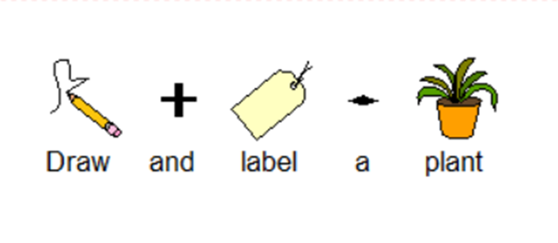

Slide 16
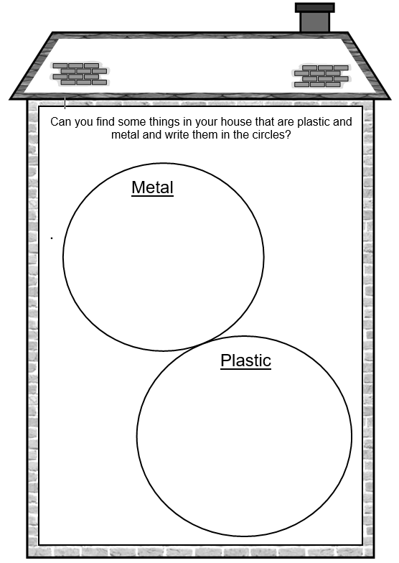


Slide 17
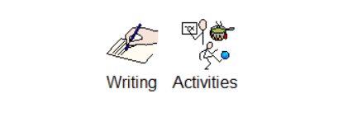
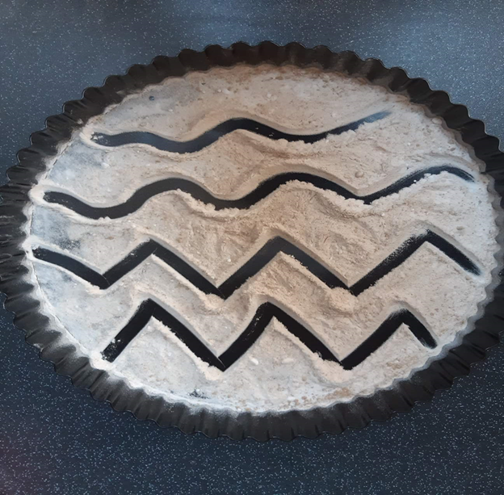
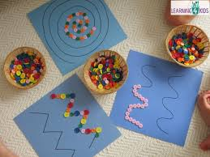
Use flour or porridge oats in a bowl or tray to practise pre-writing and fine motor skills. You could also write words and practise spellings!

Slide 18
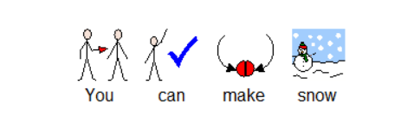
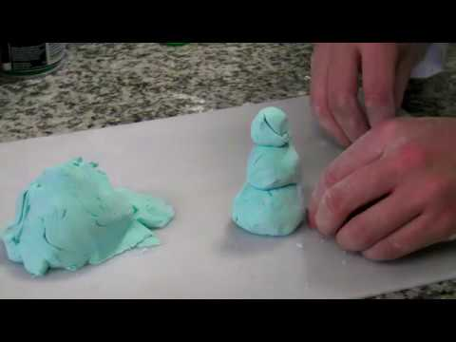
Materials:
1 cup corn starch
1 cup shaving cream
Food Colouring
Instructions:
Pour the cup of corn starch into a large bowl. Use a spoon to scoop the shaving cream on top of it. Put 5-10 drops of food colouring on top. Stir to mix.
When the mixture looks like grated cheese, use your hands to squish the mixture even more.
Pretty soon the shaving cream and corn starch will form a ball, about the same texture as dough.
If your mixture is really wet and sticky after mixing, it needs a little more corn starch. If it won’t stick together and falls into pieces, add a little more shaving cream.
That’s it! Try sculpting snow angels, snowmen, or make a tiny snow fort!
How does it work?
The tiny pieces of corn starch get mixed into the shaving cream and suspended in the mixture. Shaving cream is mad of tiny tiny bubbles, and the surface tension on the surface of the bubbles helps ‘float’ the corn starch particles when the two mix

Slide 19
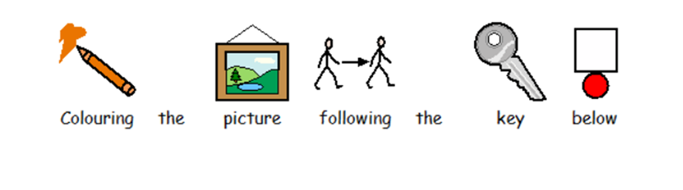
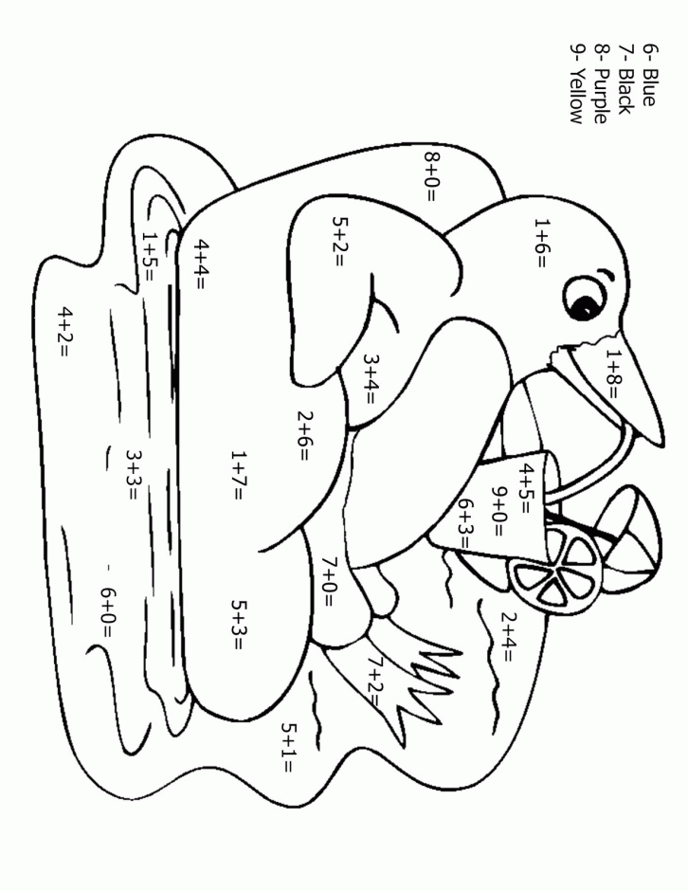
Colour by Numbers

Slide 20
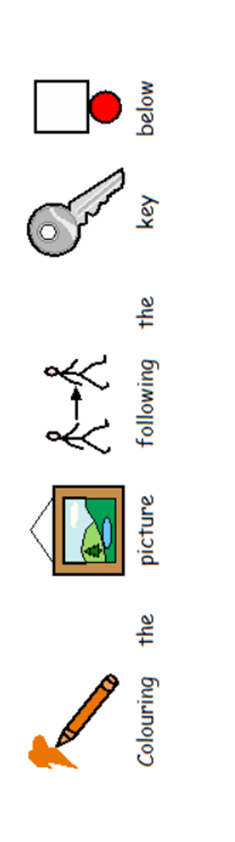

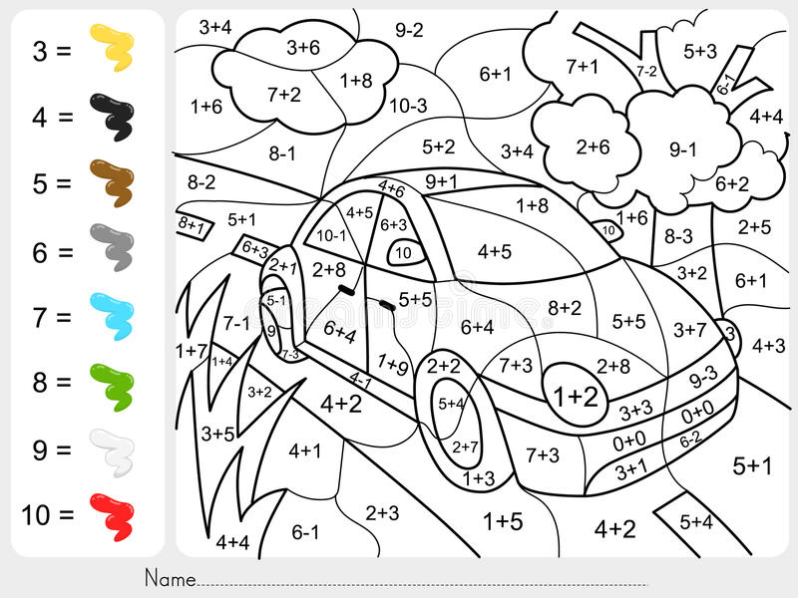

Slide 21
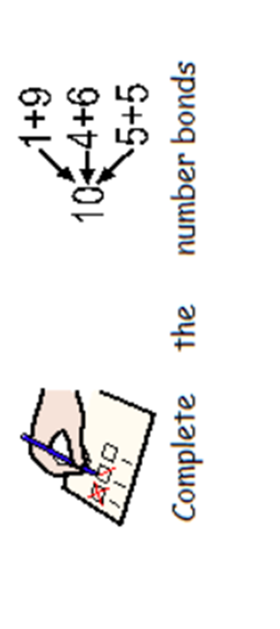
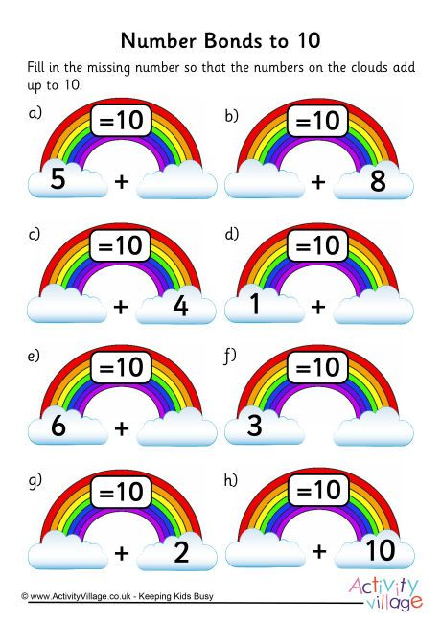

Slide 22
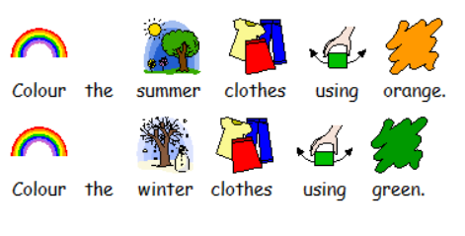
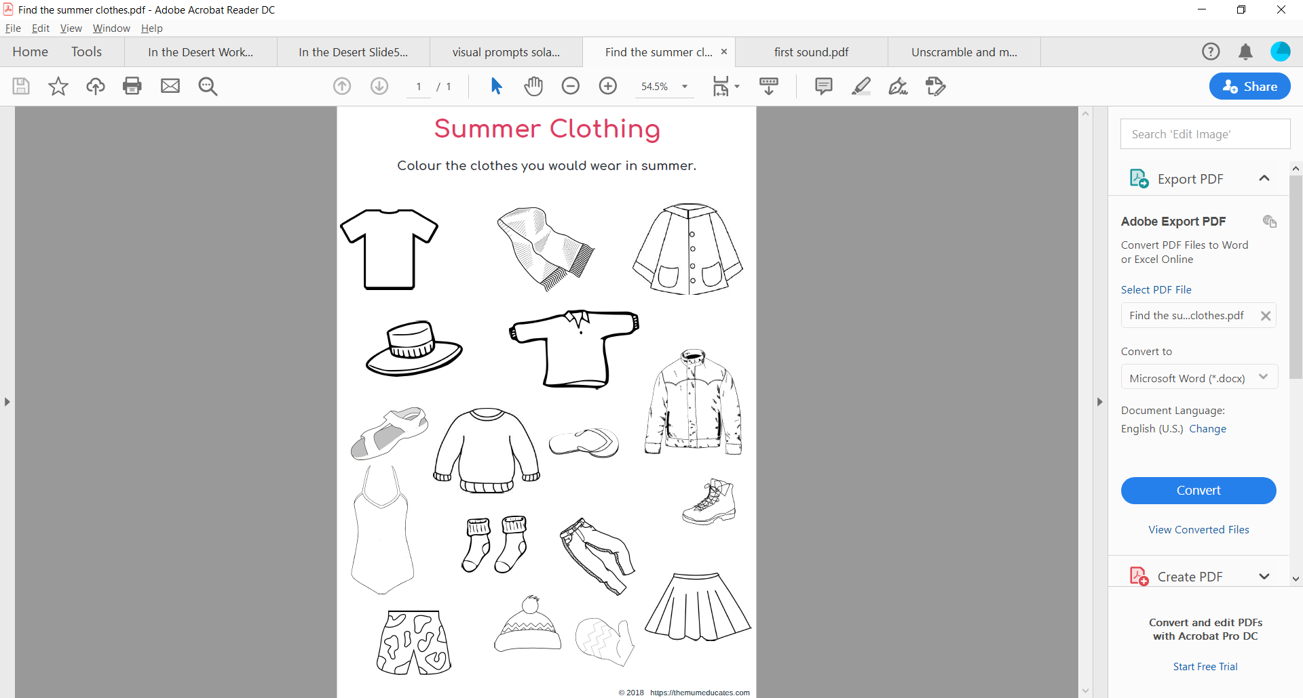

Slide 23
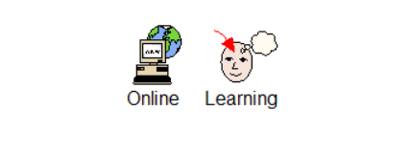


Slide 24
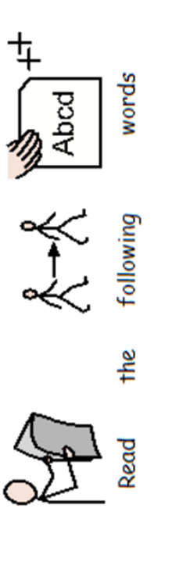
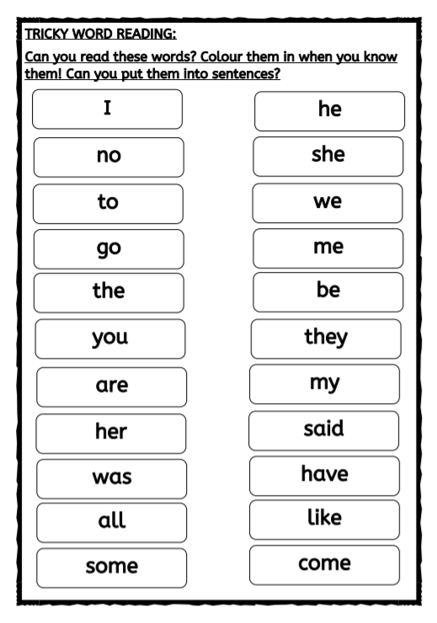
In Panda class we have been using adjectives in our writing and practising reading our own writing back. Here are some activities to practise these skills.

Slide 25
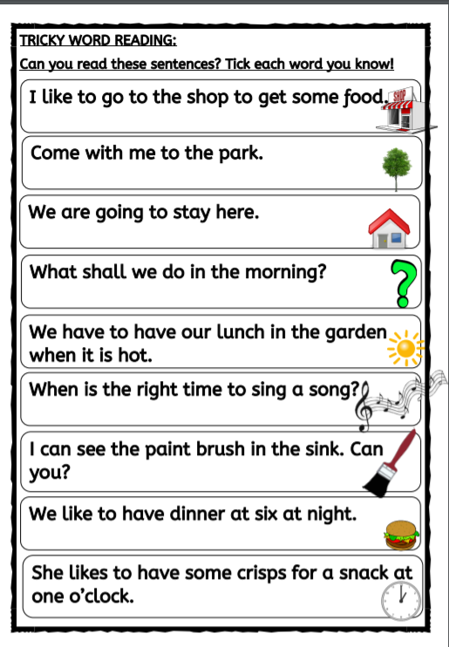

Slide 26
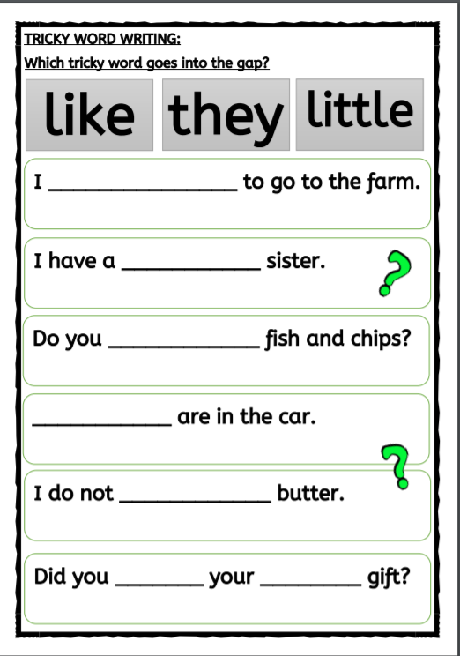

Slide 27
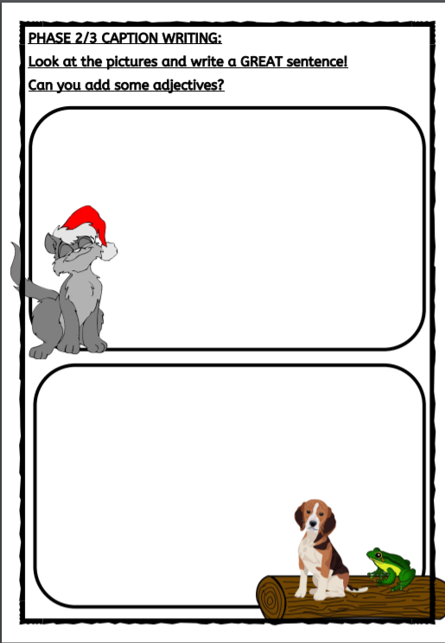

Slide 28
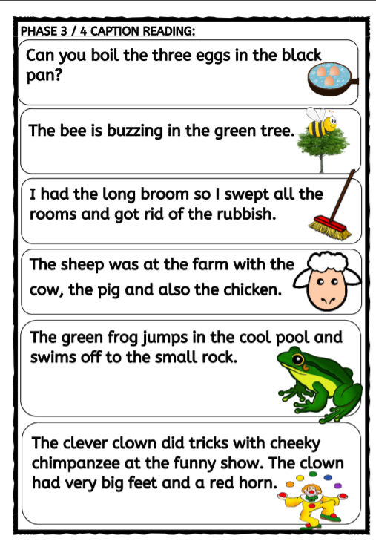

Slide 29
