Slide 1
Chanukah

Slide 2
LO: How do Jewish children celebrate Chanukah?

Slide 3
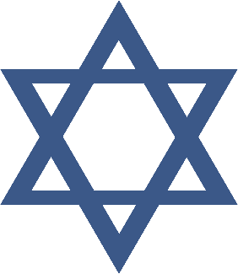
What is Chanukah?
Hanukkah or Chanukah is the Jewish festival of light.
The word Hanukkah means rededication. This means to make something special after it has been broken.
It is a story from a long time ago, before the story of Jesus being born on Christmas Day.
Hanukkah celebrates one of the greatest miracles in Jewish history.

Slide 4
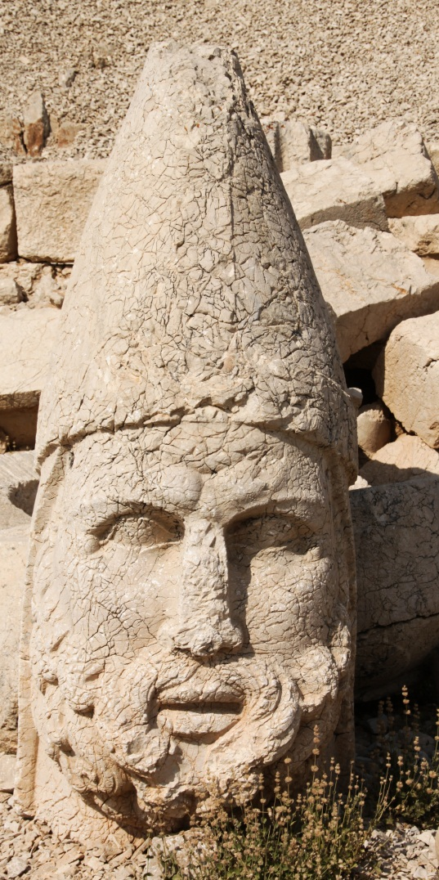
The Story of Chanukah
It tells the story of a king who was from a country from Syria. He went to a place called Jerusalem and told all the people that lived there what to do.
He wouldn’t let them do the things they had always done. They couldn’t go to their temple.
Some people who lived in Jerusalem, called the Maccabees, stopped him from hurting and upsetting people.
The Jews repaired the temple which had been ruined and rededicated it to God by lighting a lamp.
The Jews only had enough oil to light the lamp for one day, but miraculously, it stayed alight for eight days!
Photo courtesy (Klearchos Kapoutsis@flickr.com) - granted under creative commons licence - attribution

Slide 5
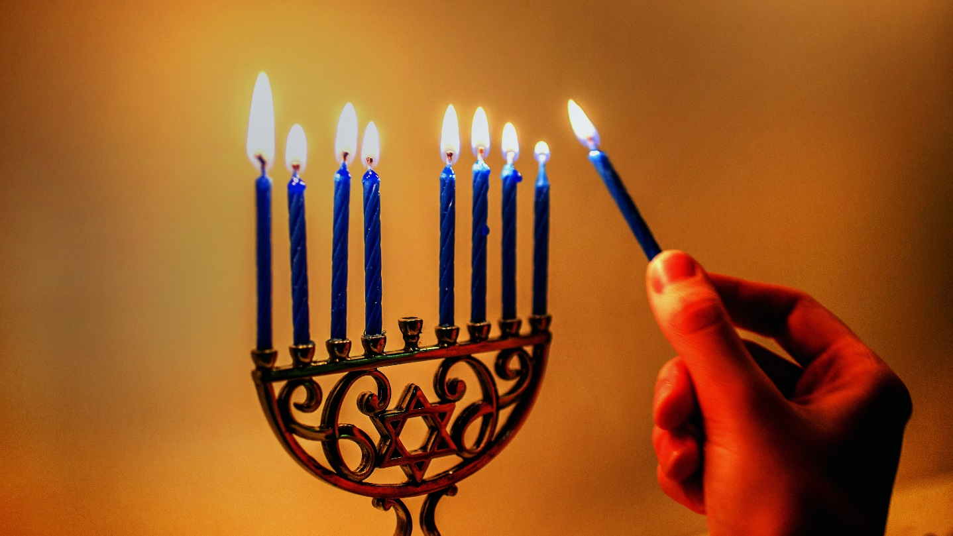
How is Chanukah celebrated?
A menorah is a special type of candle holder.
It is lit by Jewish people.
One candle is lit for each day of the festival.
How many candles can you count?
Photo courtesy (RCB@flickr.com) - granted under creative commons licence - attribution

Slide 6
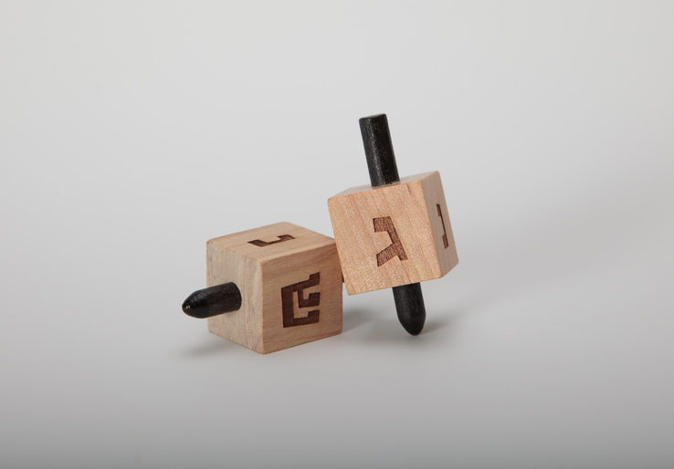
Dreidel is played.
Photo courtesy (Staccabees@flickr.com) - granted under creative commons licence - attribution

Slide 7
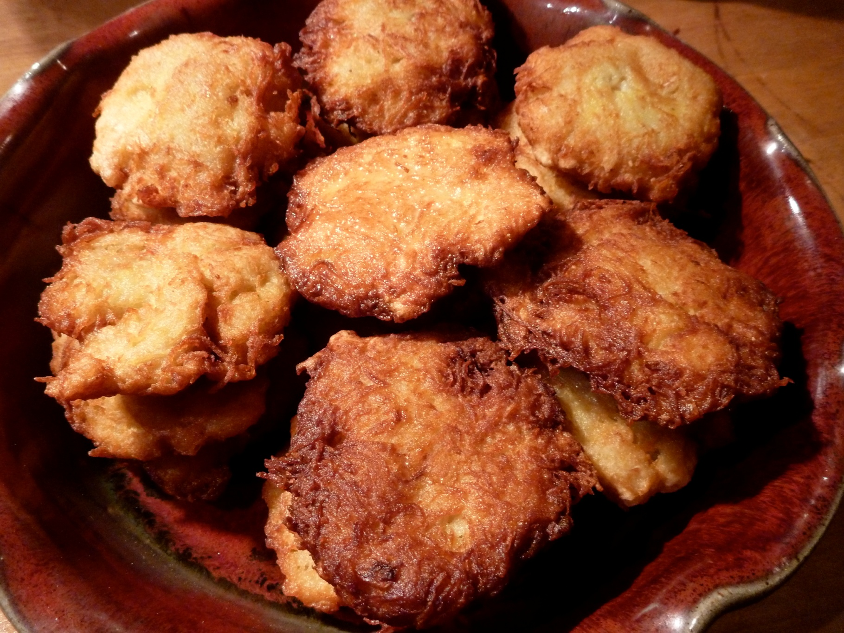
Latkes are eaten.
Photo courtesy (grongar@flickr.com) - granted under creative commons licence - attribution

Slide 8
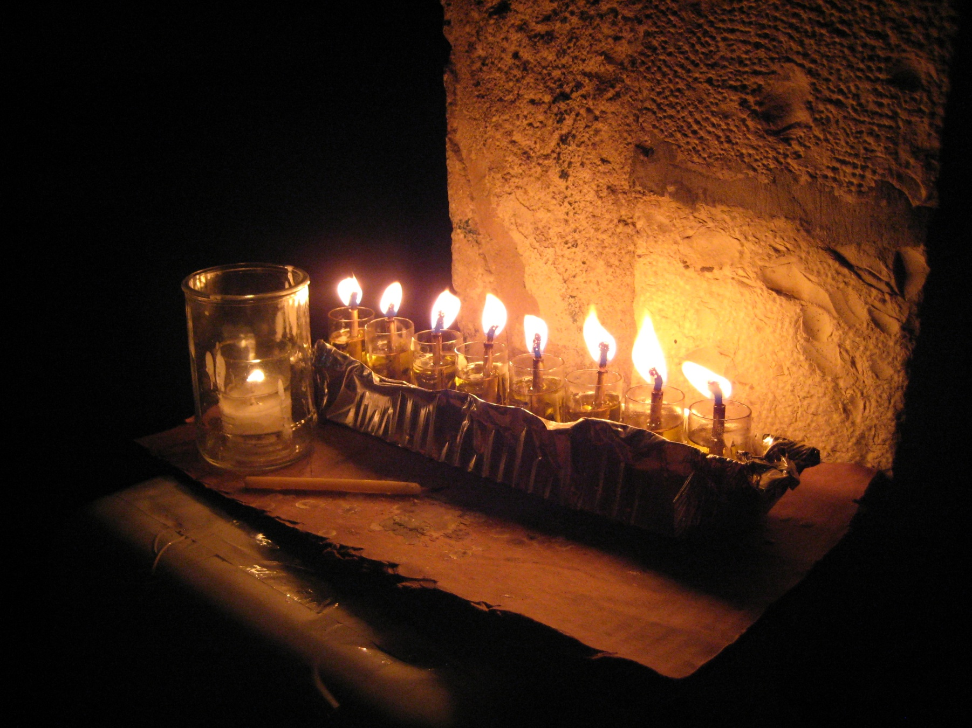
Candles are lit.
Photo courtesy (andydr@flickr.com) - granted under creative commons licence - attribution

Slide 9
