Slide 1
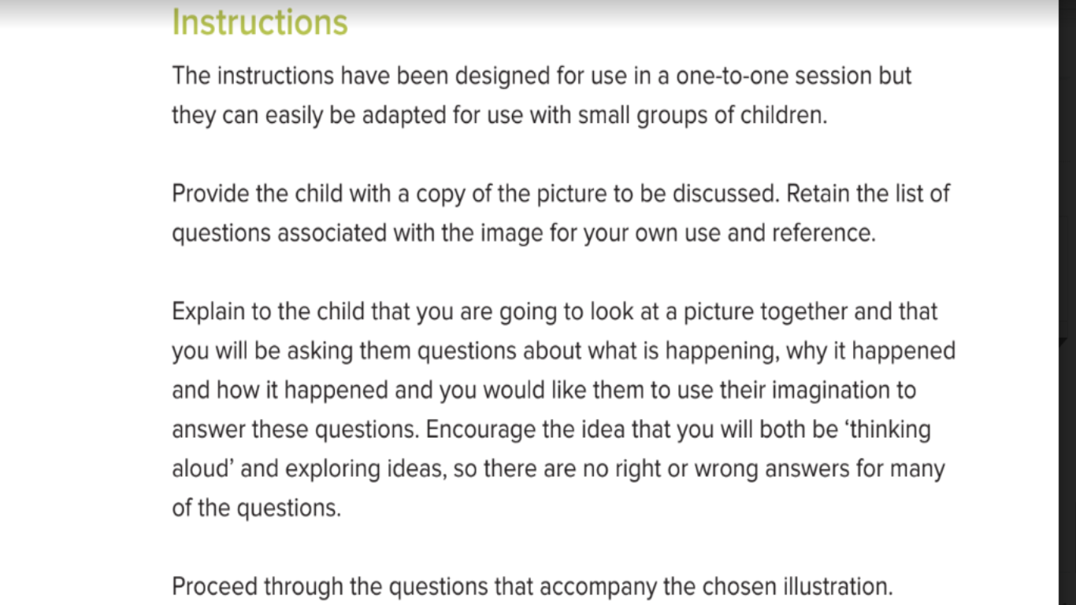
Explain, Predict and Imagine
Once all the questions have been answered, ask your child to tell you the story.

Slide 2
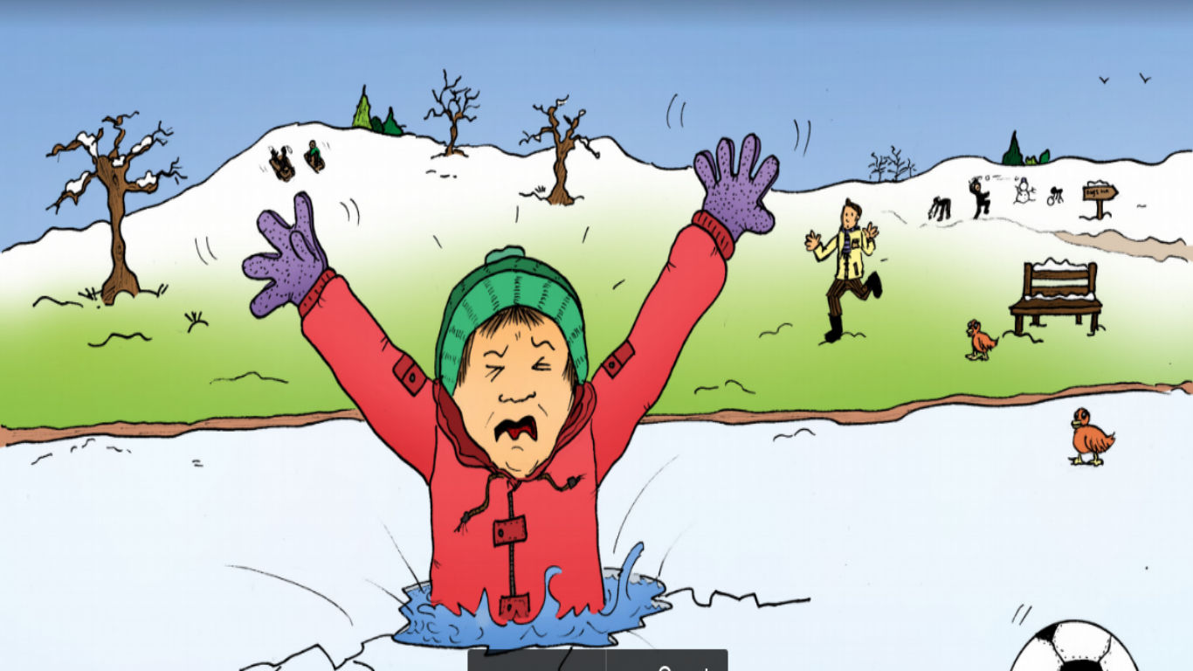
Thin Ice

Slide 3
Thin Ice
Explain- What is happening in the picture?
Who can you see? What is he doing? Where is he? When is it happening?
Why did the boy go on the ice?
How did he fall into the water?
How will he get out of the water?
Your friend stands on frozen water. Explain to him/her why this is not a good idea.
Predict-The boy went on the ice to get his football . Can you think how he could have got his ball without going onto the ice?
What may happen if can’t get out of the water?
Who made need to come and help him? How will they know he is in trouble?
What may his mum say when he gets home?
Imagine- Think of some similes to describe how the boy feels; He was as cold as
(a snowman, a freezer, ice, a polar bear in the Arctic etc.)
Imagine the boy had superpowers. What may he be able to do? How would his superpowers get him out of the pond?

Slide 4
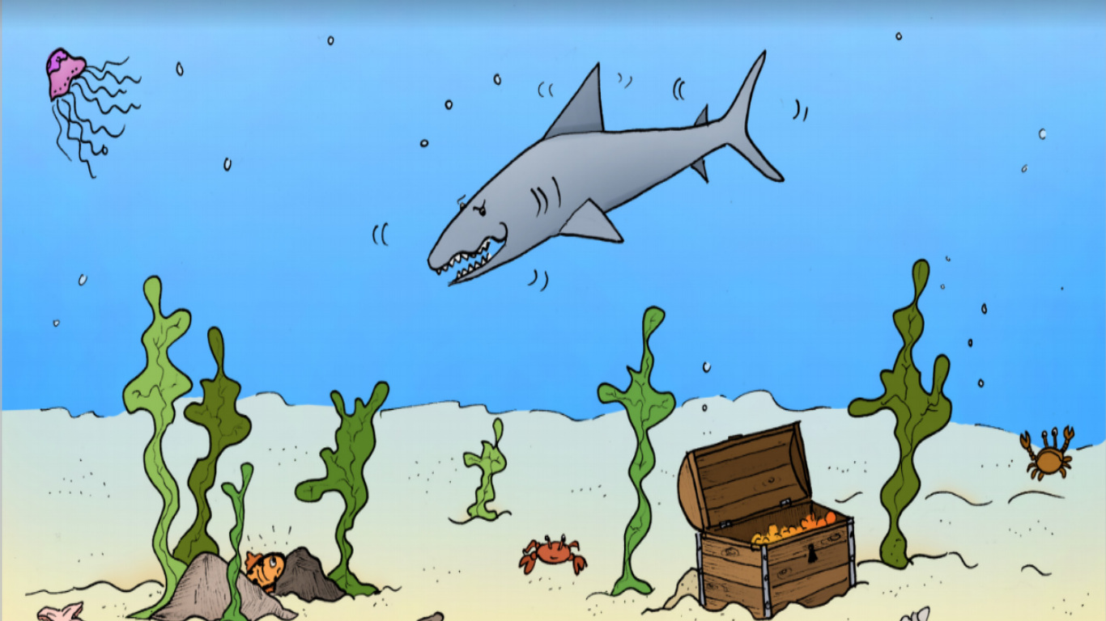
Shark Attack

Slide 5
Shark Attack
Explain- What is happening in the picture?
Who can you see? What is happening? Where are they?
Why is the little fish hiding?
How is he trying to hide from the shark?
Is there any where else the little fish could go or anything else he could do to escape from the shark?
Why are lots of people scared of sharks?
Predict-The shark is swimming past the little fish. How does the little fish feel?
What may happen if the shark sees the fish?
Do you feel the shark will be able to get to the little fish even if he doesn’t spot him?
If not, why not?
There is a man in a boat sailing over the shark. What may happen if the shark knocks the boat?
What may the man do to scare away the fish?
Imagine- Think of some similes :The shark’s teeth were like…(knives, nails etc.) The shark was as big as a …
Imagine what could happen if the little fish could change size. What may happen if he became big? What may happen if he became small?

Slide 6
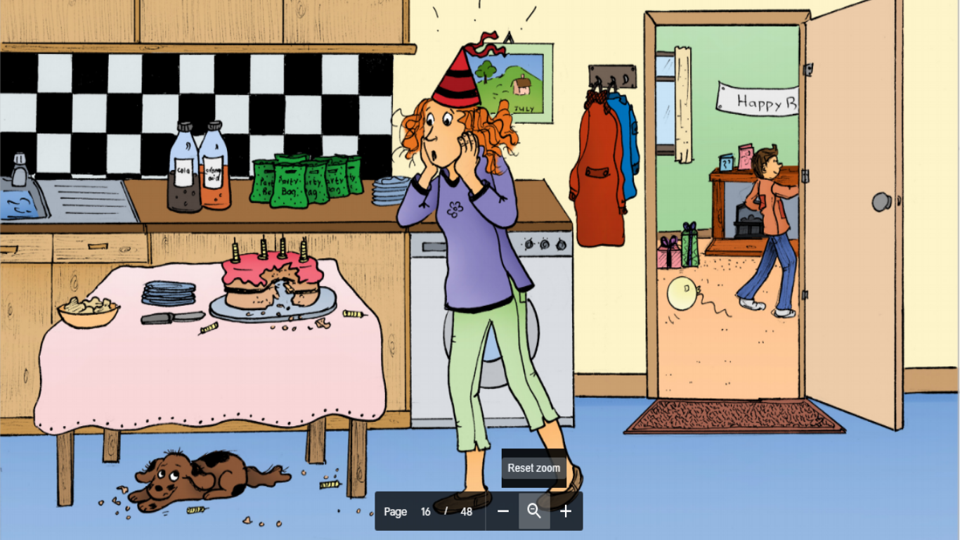

Slide 7
Who ate the cake?
Explain- What is happening in the picture?
Who can you see? What is going on? When is it happening? Where are they?
How did the dog manage to eat the cake?
Why is the dog hiding?
It’s someone’s birthday. How do you know?
What happens when it is time to eat the cake? What do you do when it’s your birthday?
Predict-The cake is ruined. How does mum feel? How will the boy whose birthday it is feel?
The dog has eaten a lot of cake. Dogs are not suppose to eat cake. What may happen?
What may mum say to the dog when she has seen the cake has been eaten?
The cake is ruined. What could Mum do?
Imagine- Think of some similes :The dog was as hungry as … (e.g. a starving lion etc.)
Imagine the dog could talk. What would he say?
Now imagine the best birthday ever. Who would be there? What would the cake be like? Where would the birthday party be held?

