Slide 1
Crumpsall Lane Primary School
COVID 19
Handbook for Parents
Updated 31st August 2020

Slide 2
Returning to School
In line with the government’s direction, and following a robust risk assessment process, we will be welcoming pupils back to school from Monday 7th September.
The government has relaxed its shielding guidelines from 1st August. If your child is classed as clinically extremely vulnerable, and has previously been advised to shield, you can now allow them to return to school.

Slide 3
School dates
We are bringing the children back into school on three different days; this is to allow us to make sure that everything is running smoothly each day and it is safer to do this with smaller numbers of children initially.
**EYFS parents have been sent their start dates separately**

Slide 4
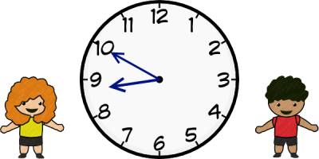
Start and Finish Times
In order to reduce the number of people outside of school we have a staggered the start and end to the school day.
Year | Start time | End time | Drop off location | Pick up location
Nursery | 9.00 – 9.10 | 2.45 | Nursery door – as shared on the school blog.
Reception | 8.40-8.55 | 3.00 | Reception doors (more info to be shared with EYFS about ways in/out)
Y1 | 8.40-8.55 | 3.00 | Y1 classroom doors
Y2 | 9.00-9.10 | 3.15 | Come through double gates at end of KS1 playground and through first aid door onto KS1 corridor? | KS1 playground
Y3 | 8.40-8.55 | 3.00 | First door as usual | Pick up on playground
Y4 | 8.40-8.55 | 3.00 | Second door (usually Y5/6) | Pick up on playground
Y5 | 9.00-9.10 | 3.15 | First door (usually Y3/4. Straight up the stairs past PPA room and onto Y5 corridor) | Pick up on playground
Y6 | 9.00-9.10 | 3.15 | Second door as usual (straight up back stairs and into the hall to their classrooms) | Pick up on playground

Slide 5
Start and Finish times
Only one parent is to bring their child to school is we can reduce the number of adults on the school grounds.
There will be a one-way system in place which must be used at all times:
Crumpsall Lane Playground Gate – Entrance Only.
Crumpsall Lane Office Gate – Exit Only
Sherdley Rd Car Park Gate – Exit Only
Sherdley Rd Playground Gate Entrance Only
Reception Side Gate – Exit only
Please use Willow Hill Road to access Sherdley Road if you are only accessing KS1 or EYFS. Only enter KS2 playground if you have KS2 children.
When on the school grounds, we ask parents and carers to stick to social distancing guidance and set a good example to the children.

Slide 6
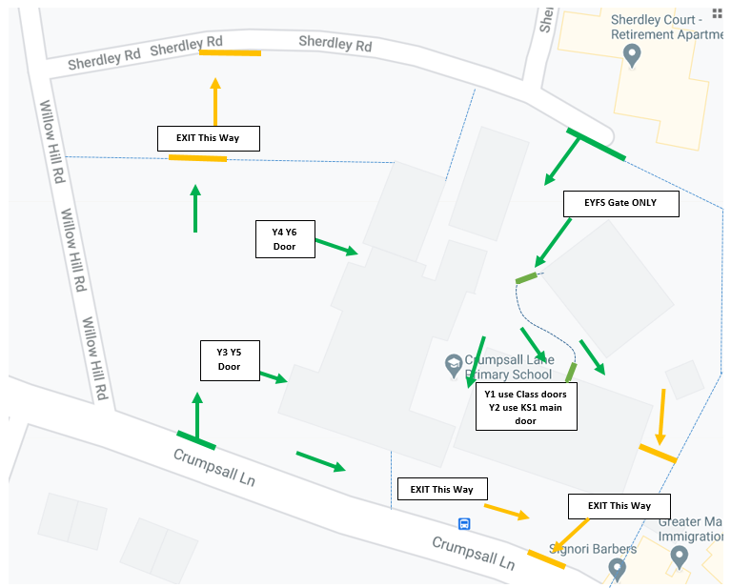
One –way system
There will be lots of school staff outside to support you in the first few weeks, so don’t worry if you are unsure or anxious.
We will help!
The system is there to protect us all.

Slide 7
Attendance
Attendance for pupils coming into school will be recorded as normal. If, at any time, your child cannot attend school because they have to self-isolate, whether this is because they are ill themselves or have been in close contact with someone who is positive, please let the school office know as soon as possible on 0161 740 3741. You will not be penalised if your child cannot attend due to following clinical or public health advice to stay at home.
Please see the Coronavirus related absences quick reference guide on the school website for more information.

Slide 8
Bubbles
The children are in year group bubbles, which means there may be parts of the day where they are spending time with children from the other class in their year group (for reading and phonics, for example). However, most children will be working in their own classroom for the majority of the day.
We have arranged for all year groups to have staggered break and lunch times.

Slide 9
Bubbles
Unless absolutely necessary, we are asking parents and carers not to come to the school office. Please phone instead wherever possible.
We kindly ask that parents do not enter the school building or gather in groups on or outside of the school premises.
Children are to bring their PE kit to school as normal
Class sizes will be back to the usual pupil number.
Individuals within a bubble will not be permitted to mix with members of another bubble.
Each bubble will have its own classroom, learning area and designated outdoor area for breaktime and PE lessons.
Members of staff will minimise their close contact with pupils and other staff; however, staff will be able to move between bubbles in order to deliver the full curriculum.
Children need to bring their full PE kit into school, as normal.

Slide 10
Bubbles
Desks and chairs in classrooms from Y2-Y6 will be front-facing where possible and placed as far apart as possible.
Frequently-used equipment, e.g. pens and pencils, will be provided by school and the children will have their own set on their tables. Please do not bring in additional pencil cases or equipment from home.
Classroom resources, e.g. books, can be shared within bubbles, but will be rotated leaving a period of time before being given to the next pupil.
Communal resources, e.g. art equipment, will be arranged into year groups and rotated.
Communal areas, such as toilets, will be cleaned frequently.

Slide 11
Personal Protective Equipment (PPE)
The government has recommended that staff and pupils do not need to use PPE in a primary school; however, staff will use PPE if a pupil shows symptoms of coronavirus and safe distance cannot be maintained.
Staff will also wear PPE if they would normally wear it to carry out their role, e.g. where a child requires intimate care or is receiving first aid following an accident or injury.
Some staff may wear a mask or visor when moving around the building and may wear a visor in the classroom, if their personal risk assessment deems this to be necessary.
Any pupils or staff who come into school wearing a face covering will be instructed to safely remove it upon entering the premises.

Slide 12
Equipment
To minimise the risk of potentially transmitting infections between pupils’ households and the school, we ask that pupils do not bring non-essential items from home into school with them.
Essential medication and medical equipment
Coats and other essential outdoor wear
Spectacles and spectacle cases
Packed lunches
Reading books
Washed PE kits
Swimming kits, when this resumes
Bags
**EYFS children to also provide a clean, change of clothes**
If your child needs to bring an item to school that is not listed
above, please contact us as soon as possible to discuss
alternative arrangements.

Slide 13
Medication
Please ensure that all children who have previously been noted as having a medical condition e.g. asthma, have in date, labelled medication in school when they return.
This will be checked on day one and parents/ carers will be contacted if not provided.
If any medical condition has changed throughout
the period of lockdown please telephone the
school office immediately.

Slide 14
Procedure if a child is unwell
It is extremely important that all parents and pupils remain vigilant with regard to preventing, identifying and minimising the spread of coronavirus. We ask, therefore, that you read the Home School Agreement during the Coronavirus Pandemic.
This can be found on the COVID page on the school website and a paper copy will be provided to each family when they return in September.

Slide 15
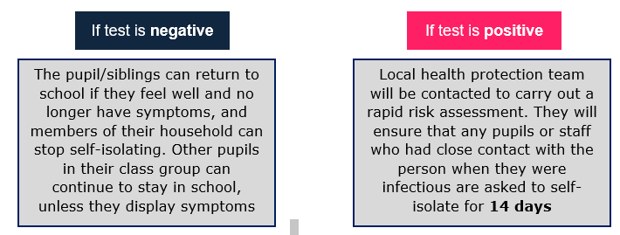
Procedure if a child is unwell
For information on what will happen if a child displays COVID symptoms please see the Responding to expected COVID case document on the school website.
If your child is sent home from school to self-isolate, they must book a test.
You may also need to engage with the NHS Test and Trace programme, if your child or anyone in your family tests positive for coronavirus.
School will provide paper copies of work to support any children who need to work at home for a period of time.

Slide 16
School dinners
School dinners will resume as normal, including for those children who are eligible for free school meals.
Children from Reception- Y2 will be entitled to universal free school meals.
Payment for school dinners must be made weekly and be brought into school by your child and where possible, not to the school office.
If your child is changing to either school dinners or packed lunches, please inform the office.

Slide 17
Breakfast Club
We will not be opening breakfast club until further notice. We will keep you updated.
After School Clubs
We will be able to offer a limited number of after school clubs. These will be operate in year group bubbles and information will be shared with parents as soon as school is settled into our new routines.

Slide 18
Transport
Pupils should walk or cycle to school or be dropped off by a member of their household where possible.
Please note that we are no longer able to use The Cleveland Car Park for parking. Parking here will result in a fine. To reduce congestion around school we advise that wherever possible, you walk to school.
Public transport should be avoided; however, if your child needs to use public transport to get to school, they should avoid peak times and follow guidelines on social distancing and wearing protective clothing, e.g. face masks.

Slide 19
The Curriculum
Our focus is to support all pupils’ health and wellbeing and to help them transition back into school life successfully. This will encourage pupils to engage in:
- Increased outdoor learning, where possible
- Increased physical education
- Increased PSHE sessions
Daily maths and English sessions – and catchup for those who need it – will run as normal.

Slide 20
The Curriculum
An adequate amount of time will be spent getting pupils up-to-speed on material from the previous term that they may have missed due to partial school closures. We have already put into place additional measures to support with ‘catch up’ and you may notice a number of additional members of support staff to facilitate this.
As always, pupil wellbeing will be our priority. We will be resuming our therapeutic intervention work and will be able to offer sessions with a play therapist where necessary. Members of staff will be available to support all pupils.
If you feel like your child’s wellbeing has been negatively affected due to the coronavirus pandemic; whether there has been a change in home circumstances, a significant event or bereavement please arrange to speak to Mrs Williams (SENDCo) or Mrs Barnes (Family support worker)

Slide 21
Behaviour
We expect the same high standards of behaviour from all pupils. We will reward pupils with house points and charms, as usual.
To ensure the school remains a safe place, we have made the decision to enforce additional rules with regards to social distancing and infection control. Pupils are expected to follow these rules. These are:
Partaking in additional hand washing.
Minimising close contact, where possible.
Minimising contact with those outside of their bubble, where possible.
Not lingering in corridors and other communal places.
Not spitting, biting, or displaying other behaviours that put others at risk.
Putting used tissues in a bin.
Queuing to use school facilities, where required.
Keeping to their classroom seating plan.
Pupils who purposefully behave contrarily to these measures and put others at risk will be dealt with in line with our Behaviour Policy.
Some pupils may find these rules difficult to follow. As adults, we will consider each situation individually and work with pupils to educate them on the importance of social distancing and infection control measures and will always reward positive behaviour.

Slide 22
Useful contacts

