Slide 1
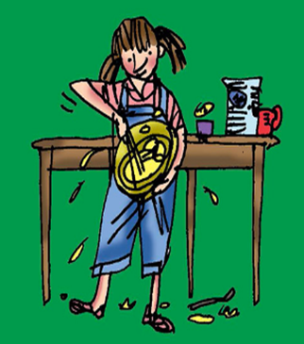
Jan’s Pancake
Activity Book
Name: _______­­­­­­____________
Date: ___________________

Slide 2
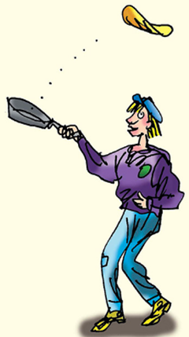
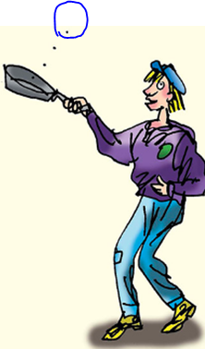
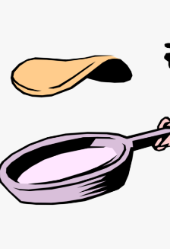
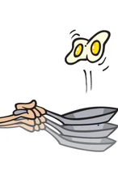
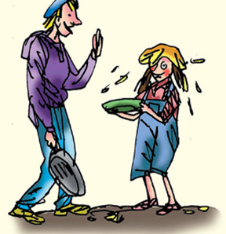
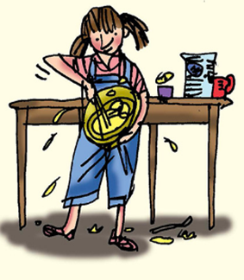
Read and Circle
A big pan and
a whisk.
Flip the pancake.
Up went the
pancake.
Run with the
pancake.
Catch it.

Slide 3
Read and Draw
Jan and Dan have a big pancake.
Dan runs with the big pan.
Splat. A pancake hat for Jan.

Slide 4
Which word
1. ______ have a pancake.
lit let’s leg
2. Pop it in the _______.
pan pot pin
3. Up went the _________.
pen pill pancake
4. “Catch it!” said _______.
Jill Jan Jack
5. Dan ran _____ the pan.
will win with
6. A pancake ____ for Jan!
hut hat hill

Slide 5
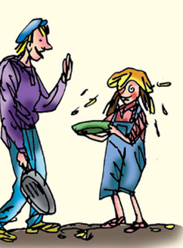
Tell the truth yes or no X
Dan is hopping.
Jan has a big pan.
The pancake is on top of Jan.
Dan has an egg in his pan .
Dan has 2 pans in his hand.
Jan is mad with Dan.
Jan has a pancake hat.

Slide 6
Word search
r | p | a | n | s | z
a | c | f | l | i | p
n | w | h | i | s | k
v | t | o | s | s | h
s | a | i | d | j | a
s | p | l | a | t | t
pan ran toss flip
whisk splat hat said

