Slide 1
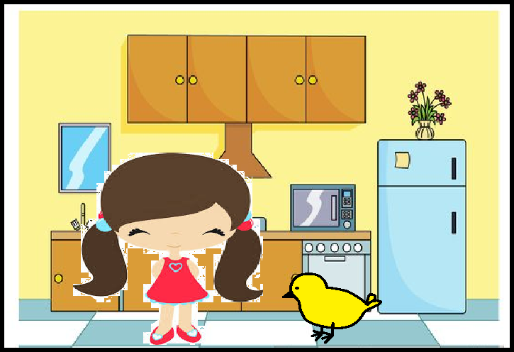
Sham has a pet chick.

Slide 2
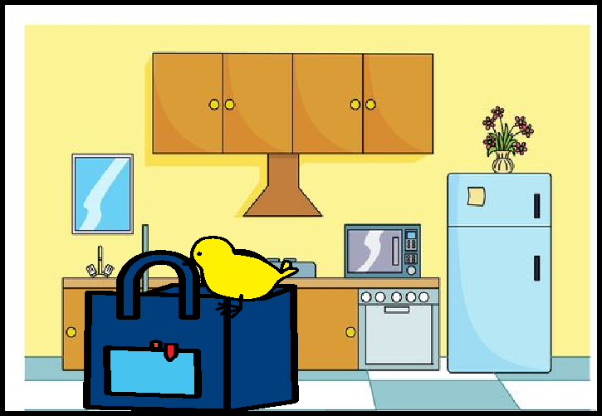
The chick went in Sham’s lunch bag. Yum, yum, yum went the chick.

Slide 3
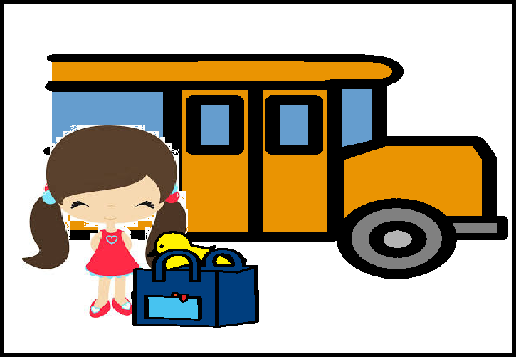
The chick hid in the lunch bag.
Sham got on the bus.

Slide 4
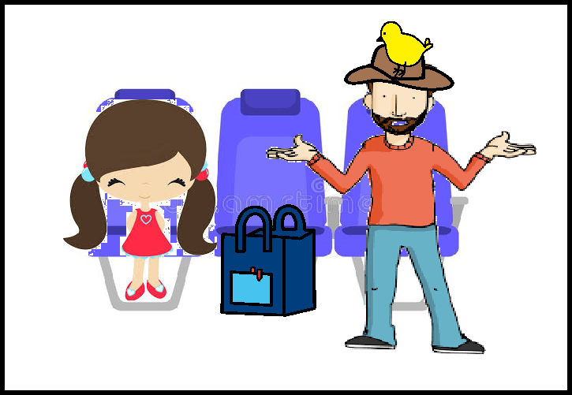
Sham sat next to a man.
The chick sat on the man’s hat.

Slide 5
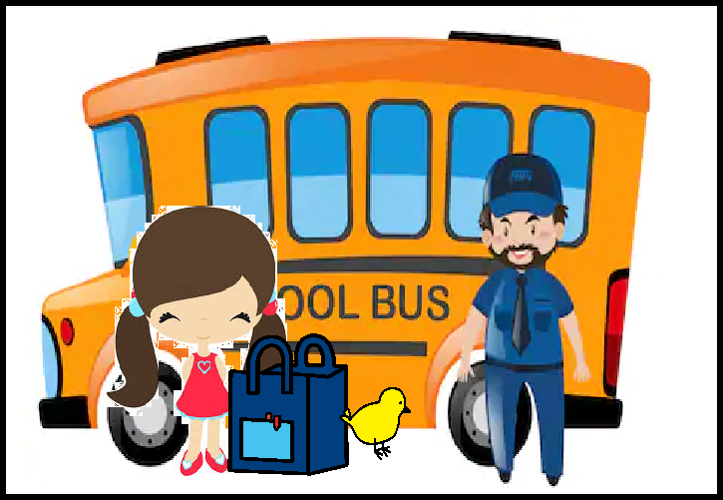
“No chicks on my bus!” Sham was mad and the chick was sad. Sham sent the chick home.

