Slide 1
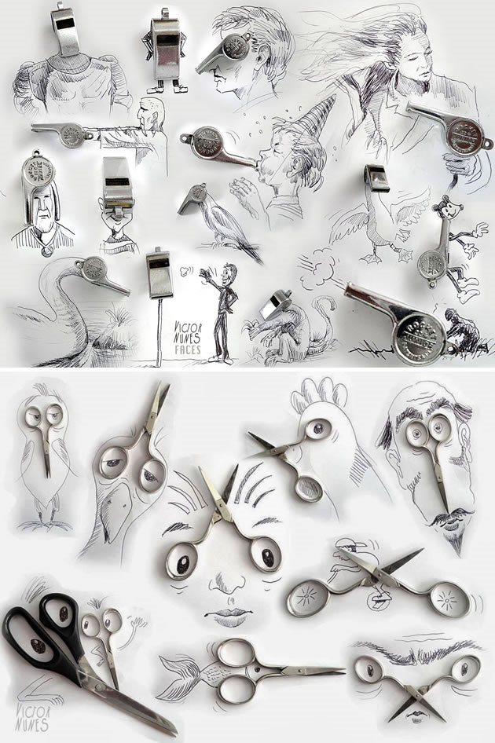
Year 6 art work Challenge
Use an object that you have at home, it could be a spoon, fork, pen, scissors, phone, whistle (like in the examples)- anything you may have in a drawer in your bedroom or kitchen and try to create your own imaginative drawing – if you have a phone or camera try to photograph your work.
We would like to see some of your designs- Bring them into school with you in September and show your Art Teacher. Good Luck and we hope you will enjoy experimenting.
These images are inspired by the work of artist Victor Nunes:

